Slide 1

This is

Slide 2
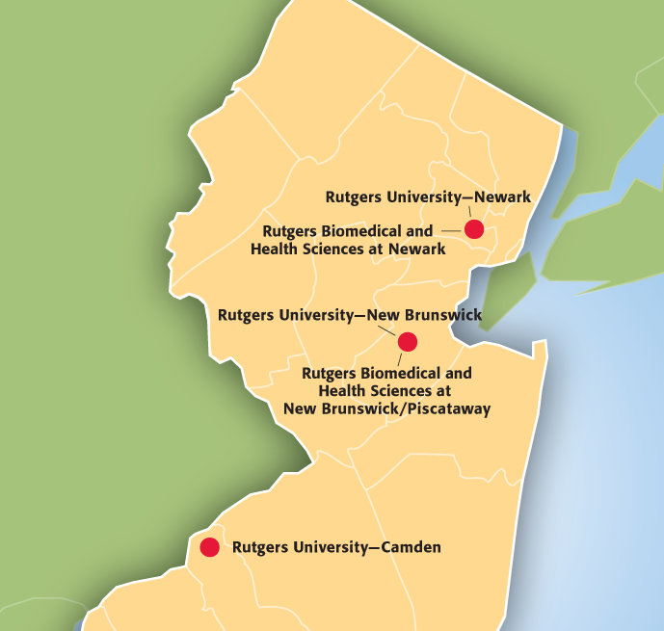
The State University of New Jersey
Educating students in northern, central, and southern New Jersey
Internationally recognized comprehensive public research university
Renowned faculty and award-winning students
Contributing to our communities through academics, research, and collaboration
2
Presentation revised August 2021

Slide 3
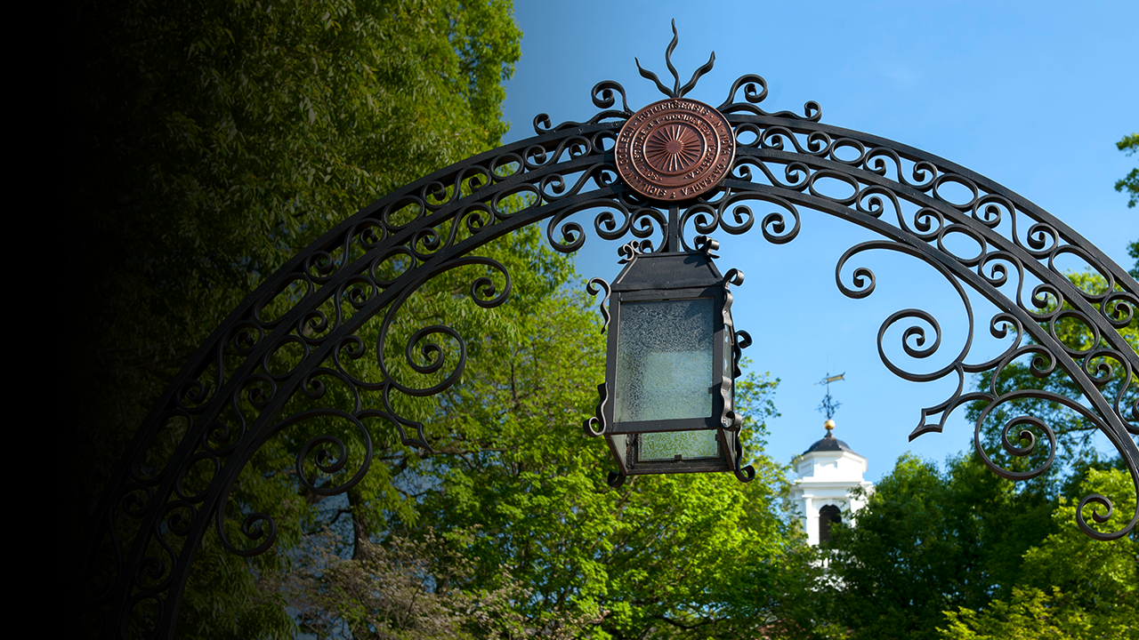
Rutgers’ Mission
Rutgers’ threefold mission focuses on
Providing for the educational needs of New Jersey through our undergraduate, graduate, and continuing education programs
Conducting cutting-edge research that contributes to the health, environmental, social, and cultural well-being of the State, nation, and world, as well as strengthening the economy and supporting businesses and industries
Performing public service in response to the needs of the people of the State and their local, county, and State governments
3
Presentation revised August 2021

Slide 4
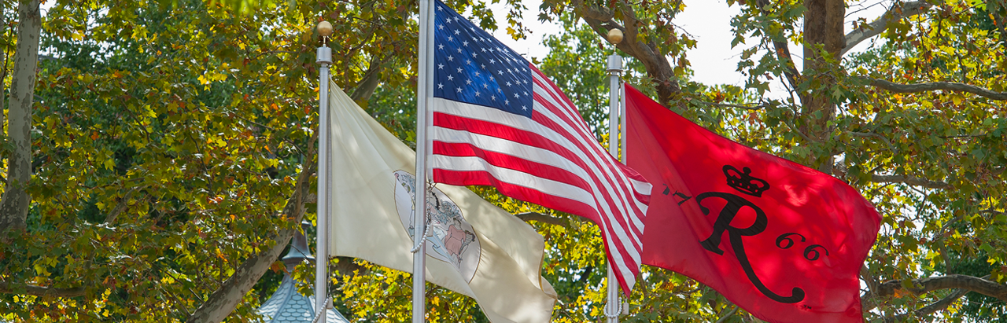
Our Focus
Improving the lives of the people of New Jersey, the nation, and the world
Preparing students for leadership and success
Applying knowledge and discoveries to address real-world needs
Providing education, research, and patient care
Benefiting the state and local communities by advancing common purposes
4

Slide 5
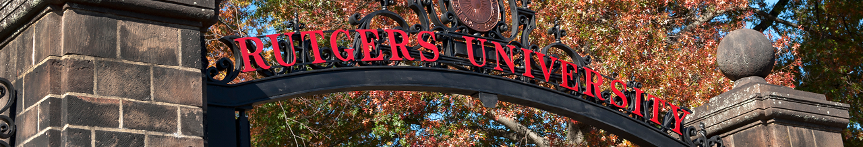
Our Structure
OFFICE OF THE PRESIDENT
University Divisions
Rutgers University–Camden
Rutgers University–Newark
Rutgers University–New Brunswick
Rutgers Biomedical and
Health Sciences
Central Administration
Academic Affairs
Ethics and Compliance
External Affairs
Finance and Administration
General Counsel
Information Technology
Institutional Planning and Operations
Research and Economic Development
Rutgers University Foundation
University Human Resources
University Secretary
Clinical Care
Rutgers Health
5

Slide 6
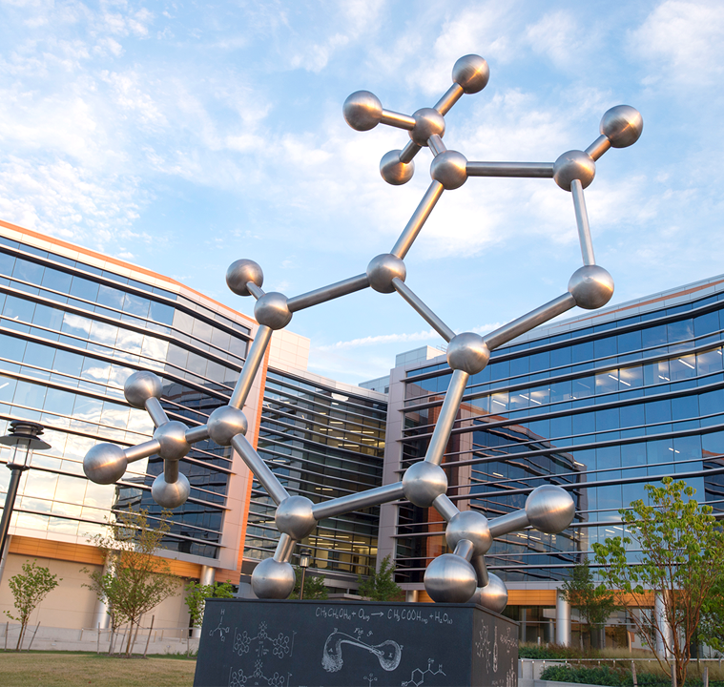
Our Strategy
Enhance the academic profile of the student body and improve retention, graduation rates, and placement in careers and graduate school
Strengthen key large disciplines while sustaining excellence in the humanities and core sciences
Recruit and retain the best faculty and create a culture that rewards great research and teaching
Improve the student experience by increasing educational opportunities, addressing social needs, and encouraging students’ academic growth and engagement
Provide best-practice academic and administrative systems
6
Presentation revised August 2021

Slide 7
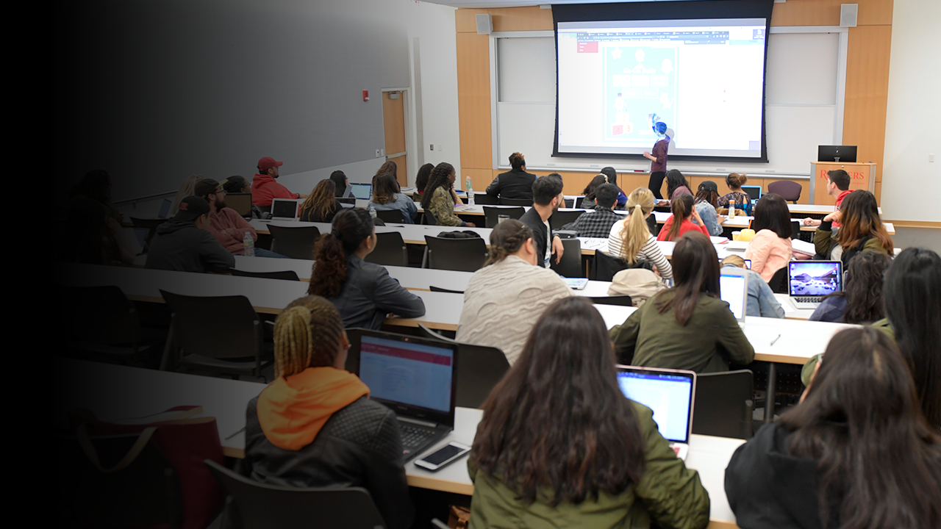
Education
Teaching over 71,000 students from across New Jersey, the United States, and the world
29 schools and colleges
150+ undergraduate majors and 400+ graduate programs
6,900+ continuing education programs
25,000+ classes taught annually
Ages 4 to 100+ taking courses as lifelong learners
18,000+ degrees granted to Rutgers students each year
7
Presentation revised August 2021. Data on this slide current as of December 2019.

Slide 8
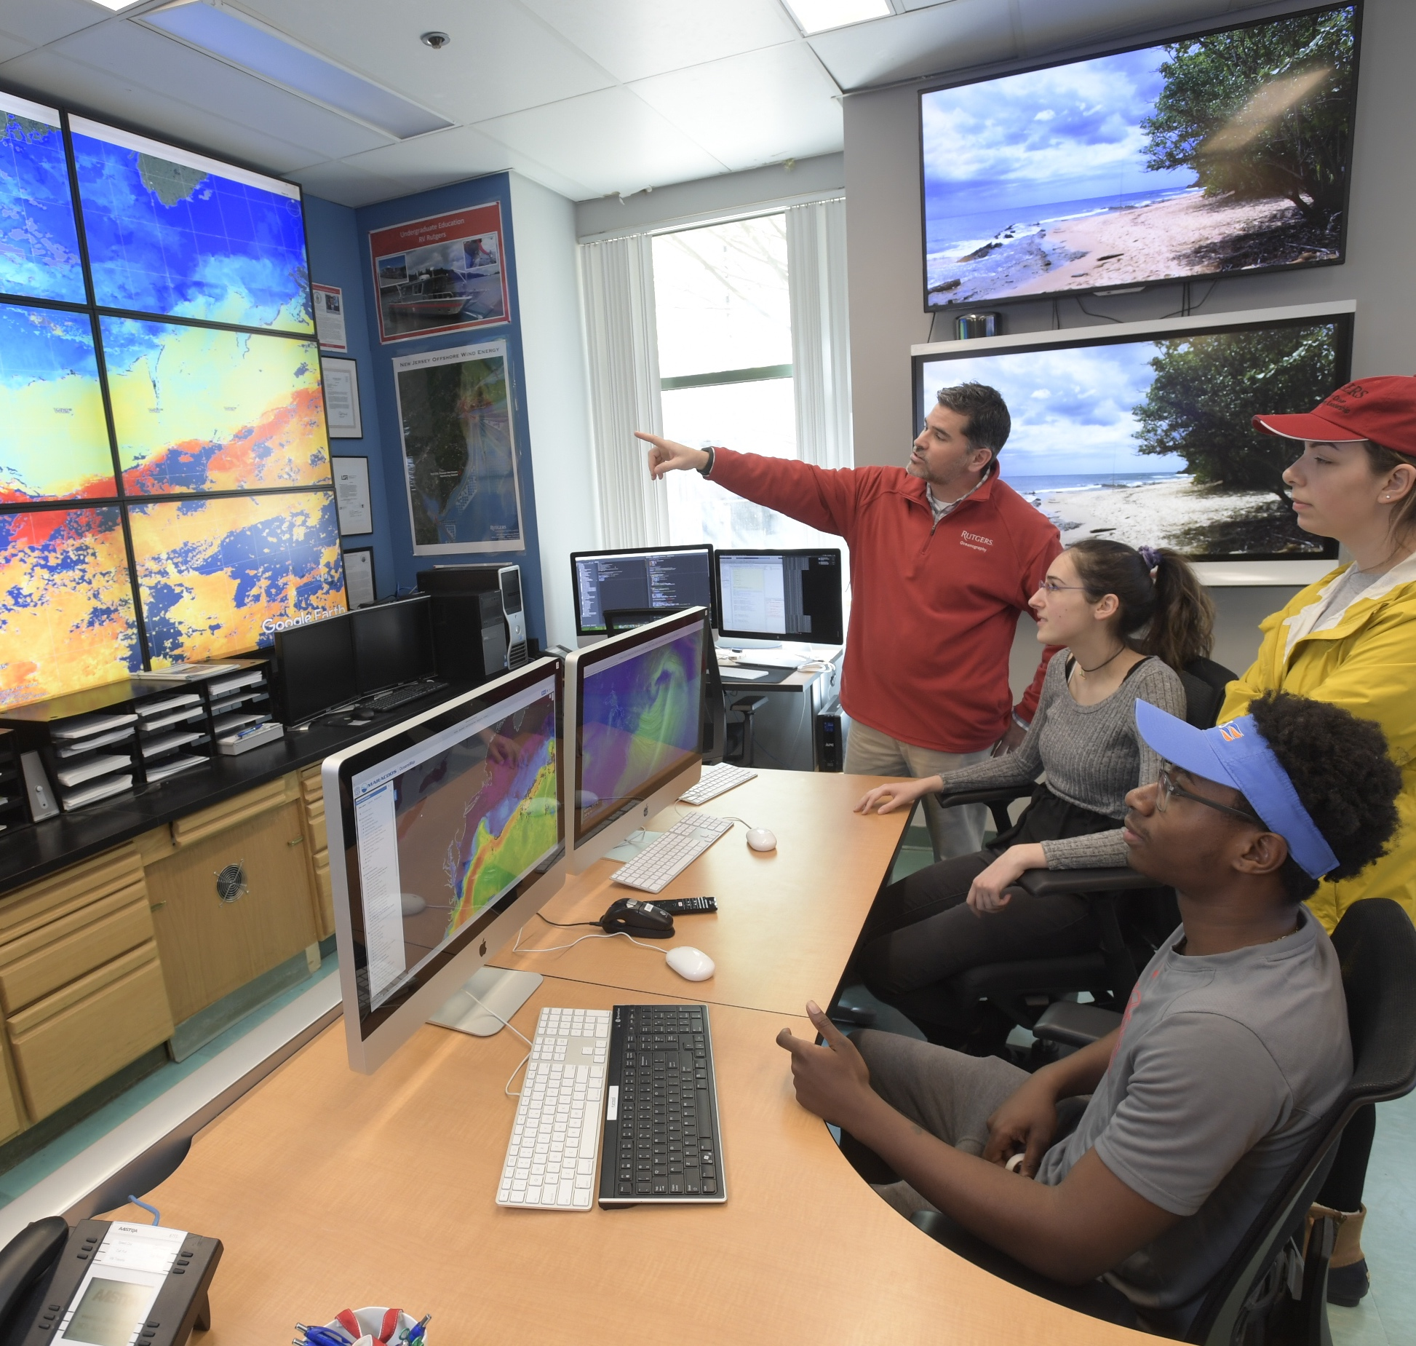
Innovation
Research with impact on people and communities around the world
New Jersey’s most extensive and diversified network of research laboratories
$737 million in R&D expenditures
in FY 2018
$610.9 million in sponsored programs and research grants in FY 2018
170+ global patents issued in FY 2018
Annual research and development expenditures exceed those of all other New Jersey colleges and universities combined
8
Presentation revised August 2021. Data on this slide current as of FY 2018.

Slide 9

Community
Collaborating with our host communities
Outreach in all 21 New Jersey counties
Working to sustain New Jersey Meadowlands, Pinelands, Highlands, Jersey Shore
Contributing 1.5 million pounds of food to address hunger
Crisis hotlines: caregivers, K–12 school employees, mothers, poison control, police officers, suicide prevention, veterans
Innovative partnerships with K–12 districts and county colleges statewide
9
Data on this slide current as of December 2019

Slide 10
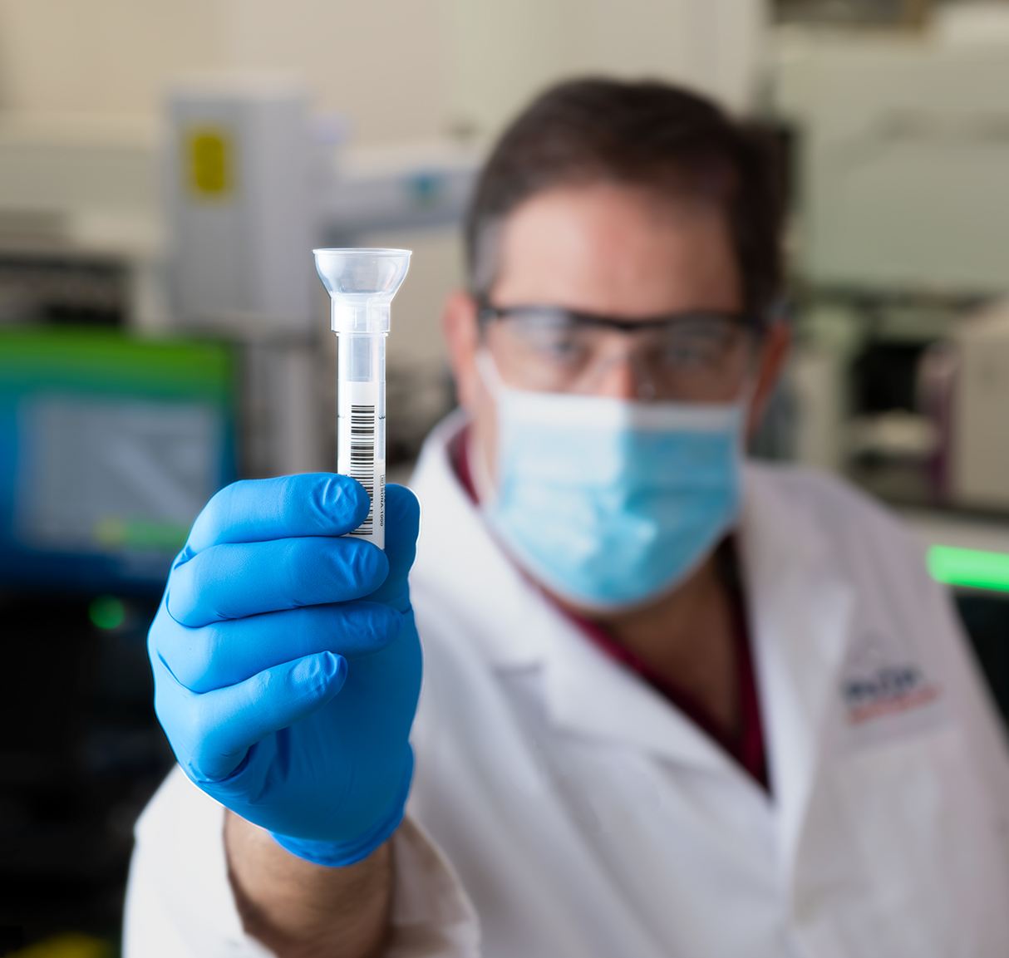
COVID-19 Response
First FDA-approved rapid “point of care” diagnostic test
First FDA-approved saliva test, including at-home version
First FDA-approved NJ clinical trial to treat patients with survivor plasma
Nation’s largest study of health care/other workers exposed to virus
10

Slide 11
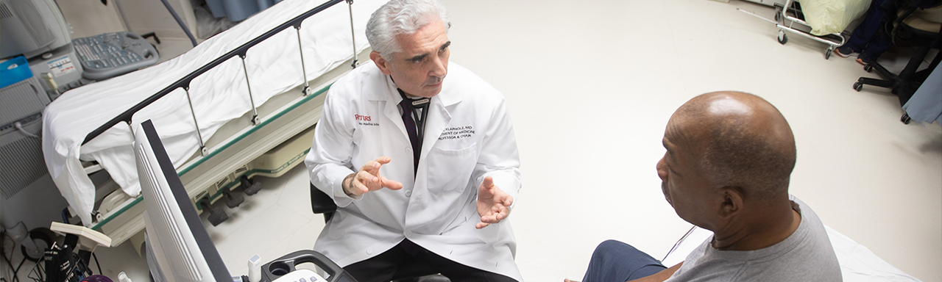
Health Care
Rutgers Health, New Jersey’s premier academic health care provider organization
2.1 million annual patient visits
Thousands of health care providers
470 ongoing clinical trials
Comprehensive health care including medical, dental, nursing, and behavioral health patient services
Rutgers Cancer Institute of New Jersey: the state’s only National Cancer Institute-designated Comprehensive Cancer Center
In partnership with RWJBarnabas Health, New Jersey's largest academic health system
World-class research that transforms patient care
11

Slide 12
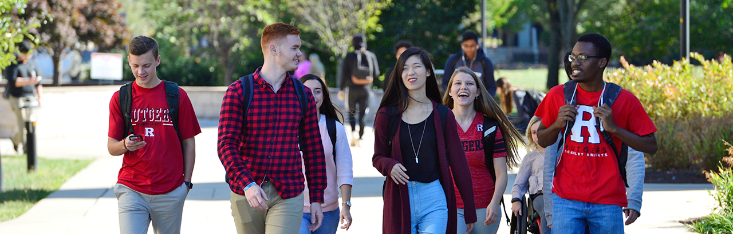
Diversity
Rutgers strives to create an environment of inclusiveness in which everyone, regardless of culture, race, and socioeconomic background, can exchange ideas freely and safely
BestColleges/Campus Pride: Rutgers named to 25 Best Colleges for LGBTQ Students
U.S. News & World Report Campus Diversity Rankings: Rutgers University–Newark ranked #2
Military Times: Rutgers ranked #4 in nation, Best for Vets
President Barack Obama, Commencement Address, May 2016, calls the Rutgers community
”… what might just be America's most diverse student body.”
12

Slide 13

Best for Vets
Rutgers ranks 4th in the nation, Military Times Best for Vets
Rutgers University–Camden named a Purple Heart University for its veterans services—the first New Jersey university to earn the distinction
Rutgers offers more than 100 continuing education programs that are approved and eligible for veteran funding
13
Presentation revised August 2021

Slide 14
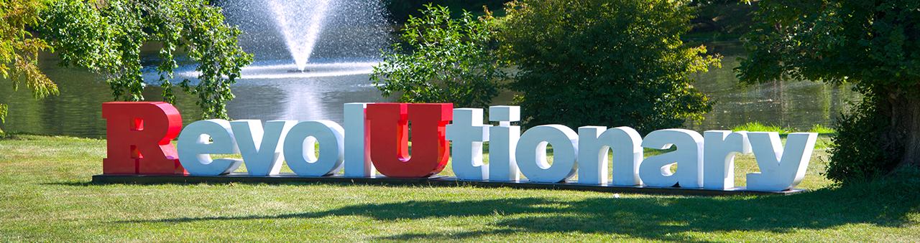
Over 250 Years
Eighth-oldest institution of higher learning in the
United States
Founded in 1766 as Queen's College as a private
all-male college; would later become Rutgers College, and now Rutgers University–New Brunswick
Rutgers University–New Brunswick became New Jersey's land-grant institution in 1864
Legislation in 1945 and 1956 designated Rutgers as
The State University of New Jersey
University of Newark (now Rutgers University–Newark) joined Rutgers in 1946
College of South Jersey (now Rutgers University–Camden) joined Rutgers in 1950, which gave Rutgers a statewide presence
  Rutgers Biomedical and Health Sciences established in 2013 with the integration of most units of the former University of Medicine and Dentistry of New Jersey
14

Slide 15
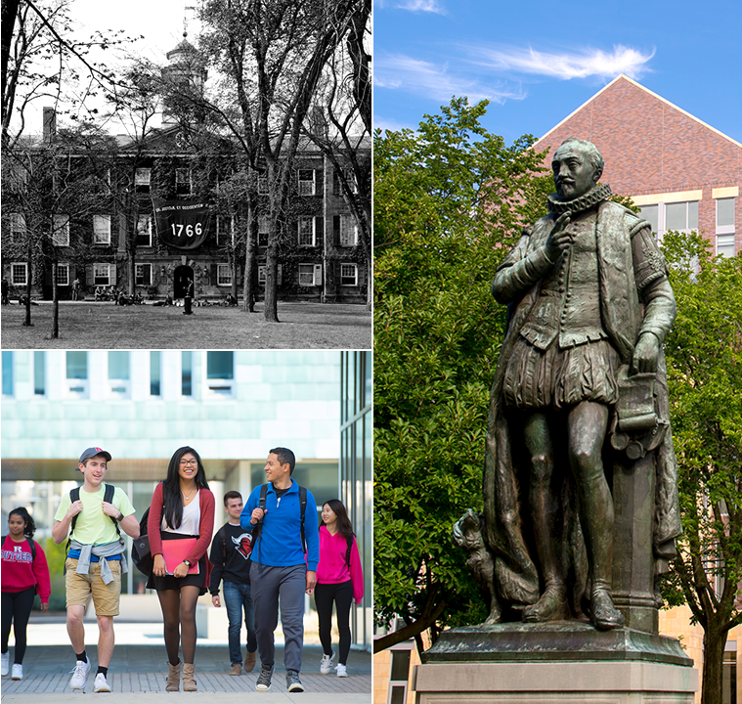
  Our Roots
  New Brunswick
Flagship of the university, Queen’s College, founded in 1766 and renamed Rutgers College in 1825
Named New Jersey’s land-grant institution
in 1864, resulting in Cook College, today’s School of Environmental and Biological Sciences
New Jersey College for Women (now Douglass Residential College) opens in 1918
Rutgers designated as The State University of New Jersey in 1945
Graduate School–New Brunswick opens
in 1952 (now School of Graduate Studies)
The experimental Livingston College founded in 1969
Rutgers College goes coed in 1972
Joins Association of American Universities, the leading 65 research universities in North America, in 1989
Joins the Big Ten in 2014
15

Slide 16
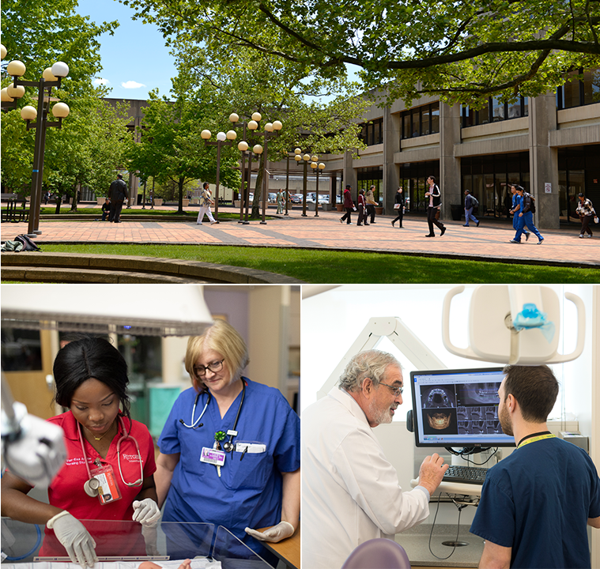
  Our Roots
  Rutgers Biomedical and Health Sciences
Established in 2013 with the integration into Rutgers of most units of the former University of Medicine and Dentistry of New Jersey
Expands Rutgers’ mission to combine research innovation with academic patient care
Rutgers Health, established in 2016, brings together comprehensive patient care: medical, dental, nursing, and behavioral health services
RWJBarnabas Health and Rutgers have launched a public-private partnership to jointly operate a world-class academic health system, the largest in the state
16

Slide 17
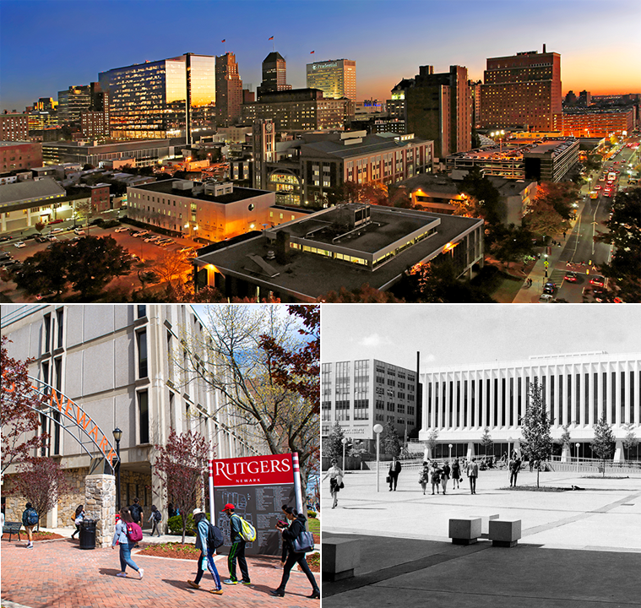
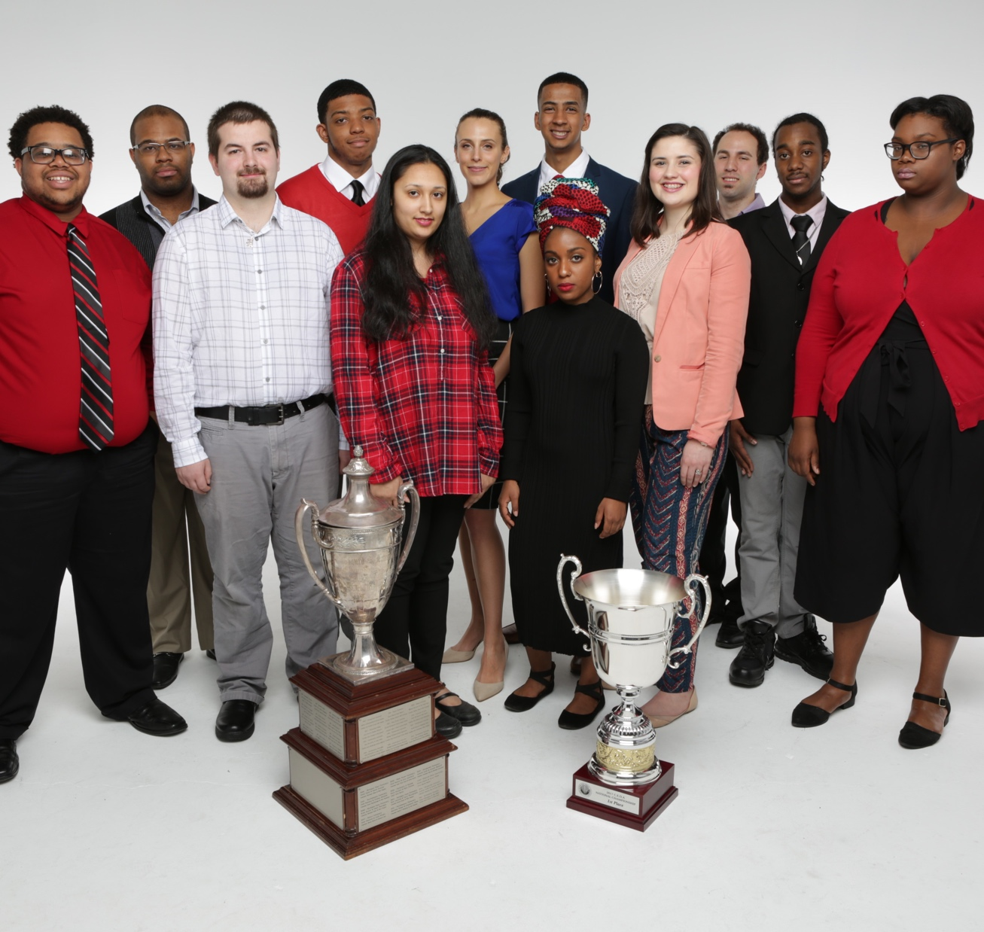
  Our Roots
  Newark
Rutgers University–Newark is a diverse, urban, research university, where opportunity meets excellence—an anchor institution in New Jersey’s largest city
New Jersey Law School opens in 1908
University College opens in Newark in 1934
Dana College, New Jersey Law School, and Seth Boyden School of Business merge to create University of Newark in 1936
The University of Newark joins Rutgers in 1946 (now Rutgers University–Newark)
Transformation inspired by takeover of Conklin Hall by Black Organization of Students in 1969
Graduate School–Newark founded in 1975
Rutgers Law School reunites the law schools in Newark and Camden in 2015
17

Slide 18
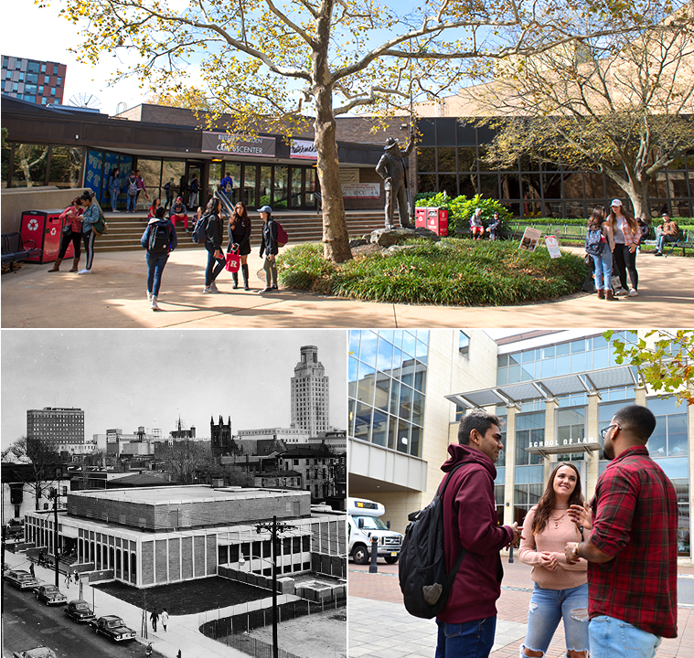
  Our Roots
  Camden
Rutgers University–Camden, a leading urban public research university emphasizing civic engagement, is a key institution for southern New Jersey and the Delaware Valley
South Jersey Law School founded in 1926; College of South Jersey opens in 1927
College of South Jersey and South Jersey Law School join Rutgers in 1950 (now Rutgers University–Camden)
School of Business–Camden started in 1988
School of Nursing–Camden started in 2011
18

Slide 19

Our Students
71,000+
students from
50 states and
130 countries
34%
of first-year students are first-generation undergrads
81%
are New Jersey
residents
Students
come from every New Jersey
county
19
Presentation revised August 2021. Data on this slide current as of December 2019.

Slide 20
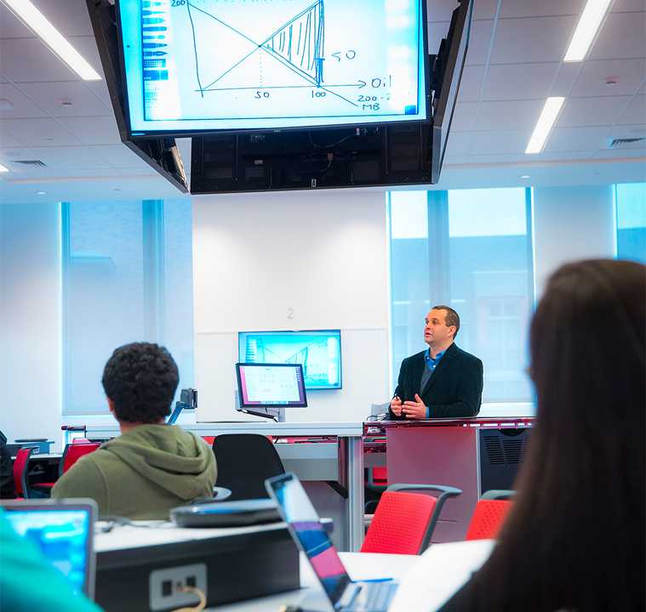
Our Faculty
Rutgers employs more than 8,700 full- and part-time faculty
Recipients of honors, awards, grants, and fellowships such as the Nobel Prize, Pulitzer Prize, MacArthur “Genius” Grants, and Guggenheim and Sloan Fellowships
40 members of the National Academies of Sciences, Engineering, and Medicine
110 American Association for the Advancement of Science fellows
More than 25,000 undergraduate and graduate classes are taught at Rutgers in a single year
20
Data on this slide current as of December 2019

Slide 21
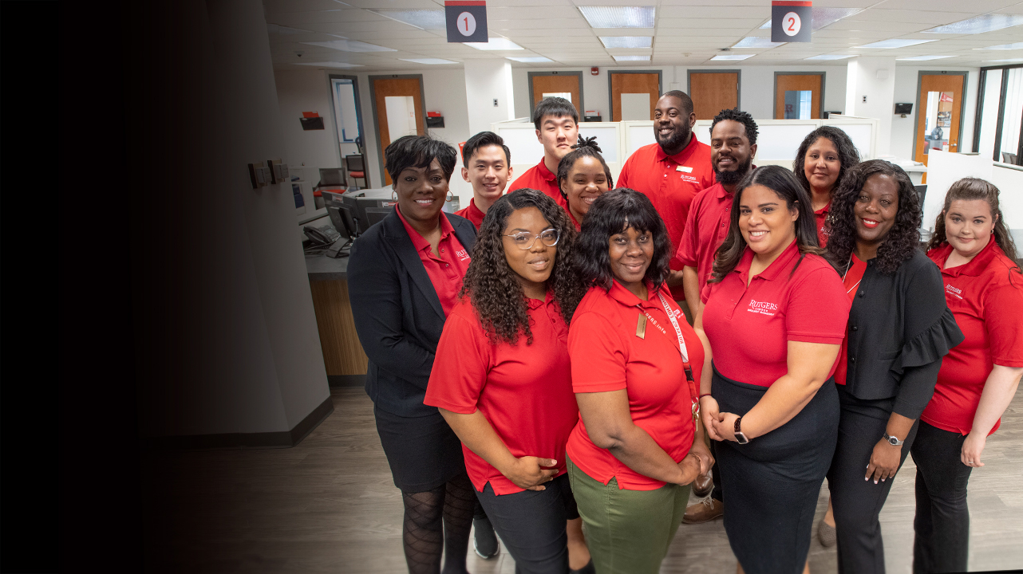
Our Staff
The university employs thousands of
full- and part-time staff
Support the university's academic,
research, community engagement,
and student life programs
1,200-plus Information Technology staff handle 2.3 quadrillion bytes of monthly internet traffic, 116,000 daily device count
on RUWireless, 2.1 million hours logged yearly on computer lab computers
Rutgers University Police Department is
one of only 17 law enforcement agencies in the state to be accredited by Commission on Accreditation for Law Enforcement Agencies
21
Presentation revised August 2021. Data on this slide current as of December 2019.

Slide 22
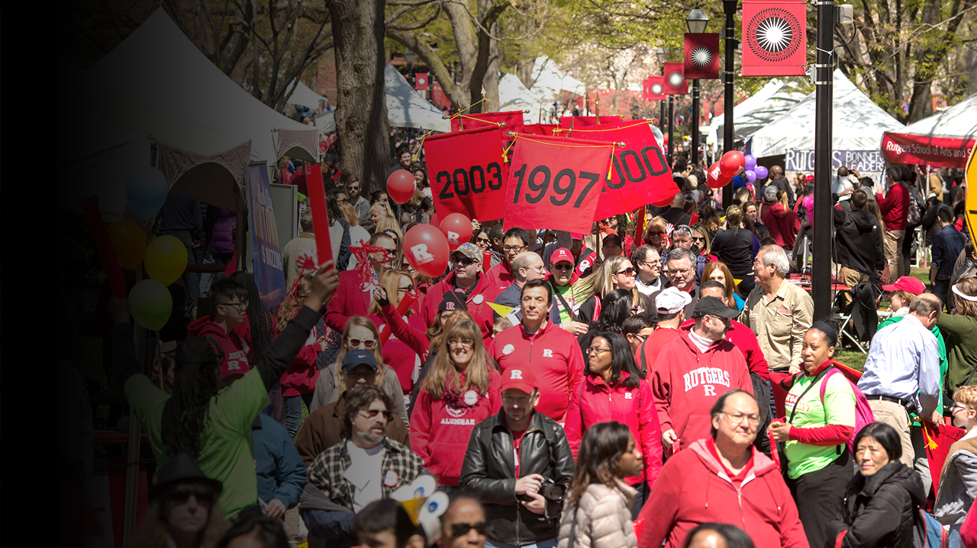
Our Alumni
More than 530,000 living alumni
More than half reside in New Jersey
106 chartered alumni organizations across North America
Work in virtually every field, from
the public sector to Fortune 500 companies
Have earned prominent recognition such as the Nobel Prize, National Medal of Technology and Innovation, Pulitzer Prize, and Emmy Award
22
Presentation revised August 2021

Slide 23
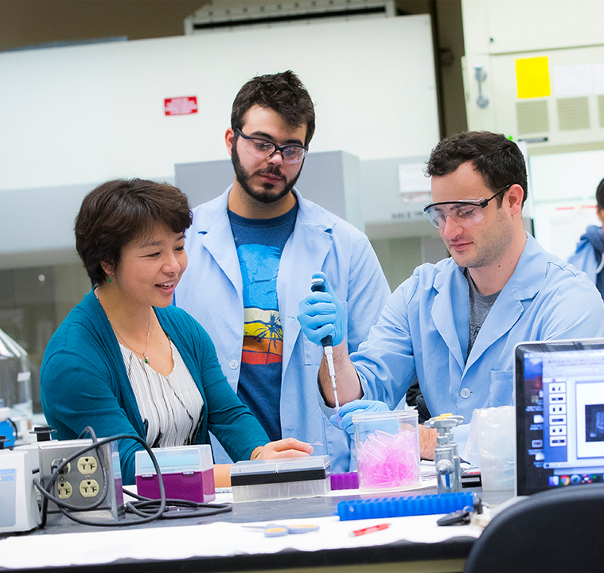
Our Difference
Focused on real-world applications of academics and research
Encourage diversity of thought and approach
An exceptional educational value
Partnering with communities, businesses, and industry to enhance academic experiences
23
Presentation revised August 2021

Slide 24
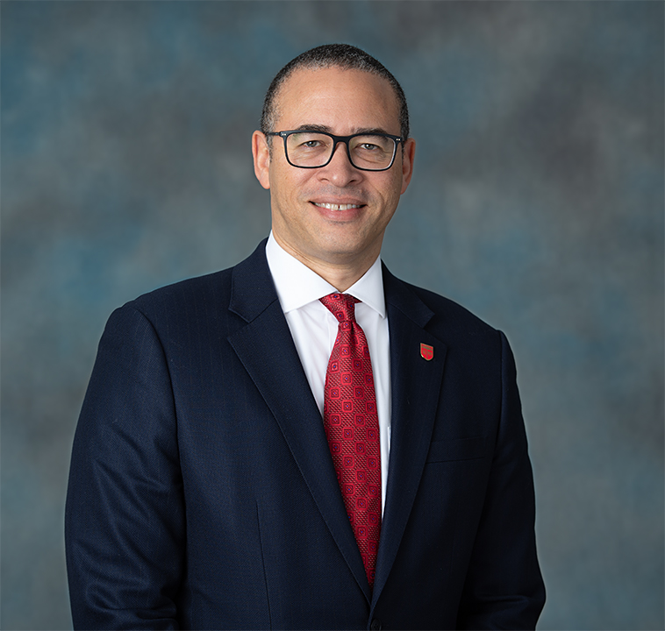
  Leadership
  President Jonathan Holloway
21st President of Rutgers
Appointed in 2020
Eminent scholar of history and African-American studies, specializing in post-emancipation social and intellectual United States history
Member of the American Academy of Arts and Sciences and the Society of American Historians
Accomplished administrator with previous leadership roles as
provost of Northwestern University and dean of Yale College
24

Slide 25
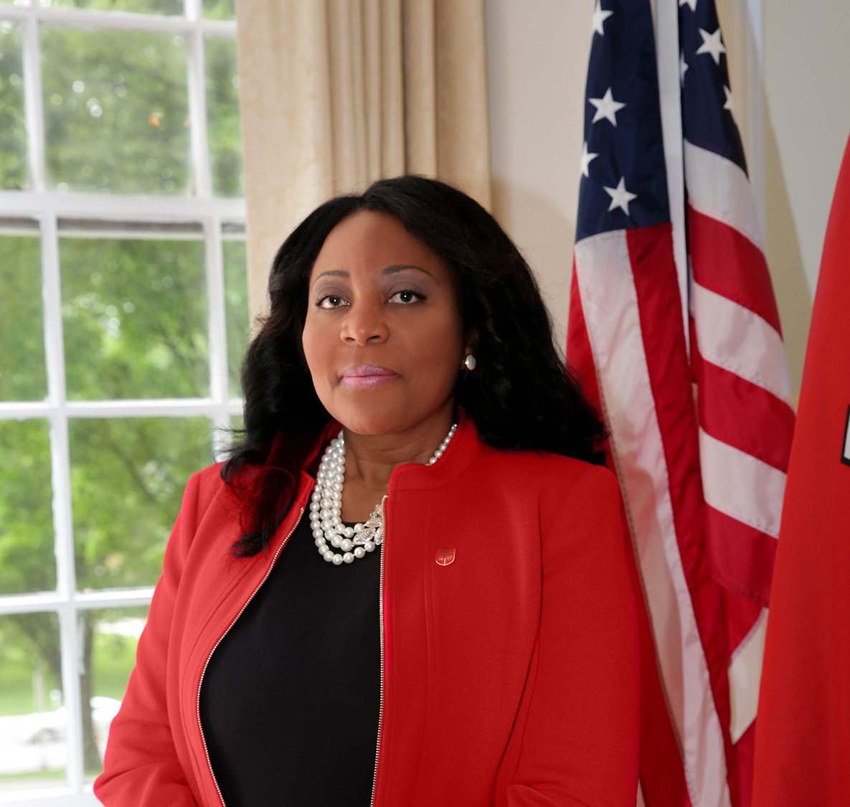
  Leadership
  Chancellor-Provost Francine Conway
Named Chancellor-Provost, Rutgers University–New Brunswick in 2021
Oversees institution with more than 43,000 students, 10,000 faculty and staff, 12 degree-granting schools
Previously provost of Rutgers–New Brunswick
As provost, advanced recruitment of faculty from underrepresented demographics and ensured pathways to success for talented students from diverse and at-risk backgrounds, and developed and expanded an infrastructure that prioritized student support, faculty research, and faculty satisfaction
Internationally recognized child psychologist and former dean of Rutgers’ Graduate School of Applied and Professional Psychology (GSAPP)
Among many accomplishments at GSAPP, established the Applied and Academic and Autism Services Division (Triple A) to unite autism service units under one umbrella
25

Slide 26
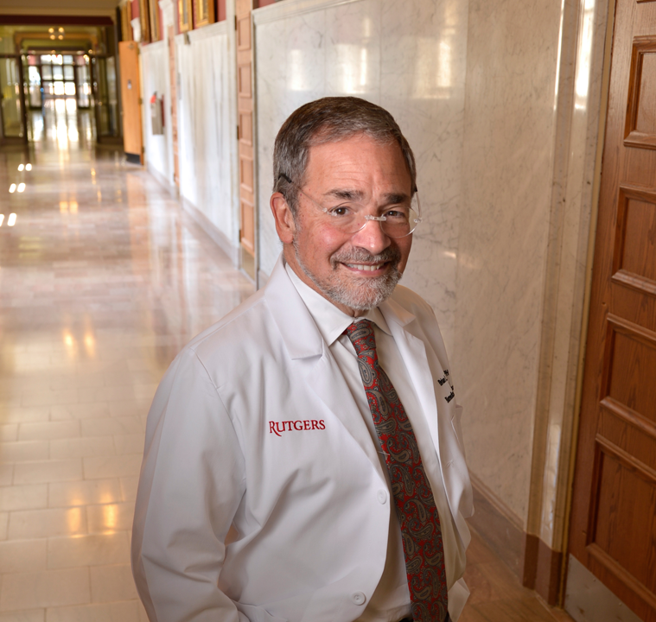
  Leadership
  Chancellor Brian Strom
Inaugural Chancellor of Rutgers Biomedical and Health Sciences (RBHS)
Executive Vice President for Health Affairs at Rutgers University
Leads the effort to strengthen medical and other health professions education and practice in New Jersey
Oversees the management of Rutgers Health
Practice spans many areas of clinical epidemiology
Major research interest is in the field of pharmacoepidemiology
Nationally recognized leader in clinical research training
26

Slide 27

  Leadership
  Chancellor Nancy Cantor
Named Chancellor, Rutgers University–Newark in 2014
Leads pursuit of strategic plan focused on access and affordability, publicly engaged scholarship, and the university’s role as an anchor institution
Recognized nationally and globally as advocate for reemphasizing higher education’s public mission
Lectures and writes on universities as anchor institutions, rewarding public scholarship, sustainability, liberal education and the creative campus, the status of women in the academy, and racial justice and diversity
Prominent social psychologist and National Academies member
27
Presentation revised August 2021

Slide 28
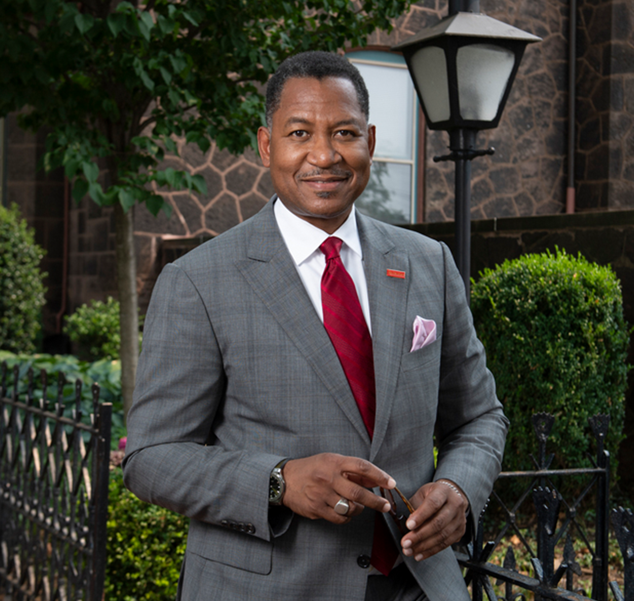
  Leadership
  Chancellor Antonio Tillis
Named Chancellor, Rutgers University–Camden
in 2021
Leads institutional commitment to serving as an anchor institution in Camden and throughout all of South Jersey and the Delaware Valley
Oversees 1,300 employees and nearly 7,000 students in 39 undergraduate programs and 28 graduate programs
Prominent scholar of Latin American literature
Was interim president, University of Houston Downtown, and dean of UHD College of Liberal Arts and Social Sciences
Skilled administrator who increased grant funds for faculty research, launched center for Arab studies, established presidential task force on diversity, and created new student internships
in Houston
Was previously dean, College of Charleston, School of Languages, Culture, and World Affairs
28

Slide 29

Athletics
Rutgers Scarlet Knights
New Brunswick, Division I
24 sports
Big Ten Conference
Birthplace of college football, 1869
Rutgers Scarlet Raiders
Newark, Division III
16 Sports
New Jersey Athletic Conference
Rutgers Scarlet Raptors
Camden, Division III
17 Sports
New Jersey Athletic Conference
More Ways to Play and
Compete
Sports Clubs
Intramurals
Recreation
29
Presentation revised August 2021

Slide 30
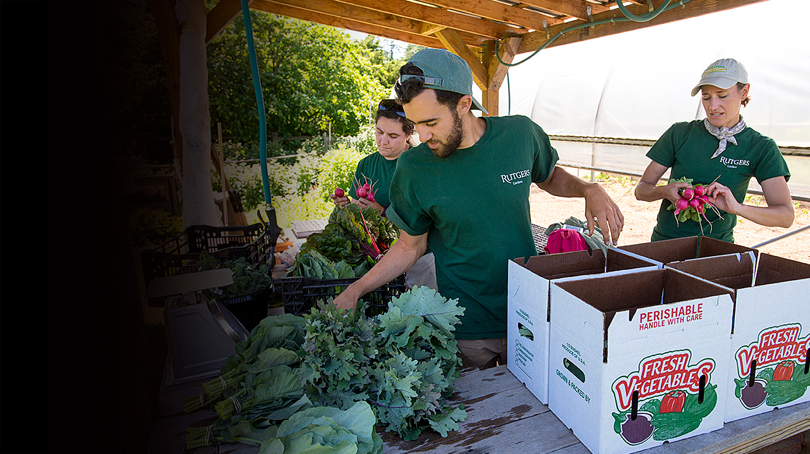
Outreach & Extension
Became New Jersey’s land-grant institution in 1864
New Jersey Agricultural Experiment Station provides a diverse range of research and educational programs through its cooperative extension specialists, helping to fulfill Rutgers University–New Brunswick’s
land-grant role
Serves residents in urban, suburban, and rural communities in all 21 New Jersey counties
Continuing education programs serve more than 83,000 lifelong learners
annually between ages 4 and 100+
30
Presentation revised August 2021

Slide 31
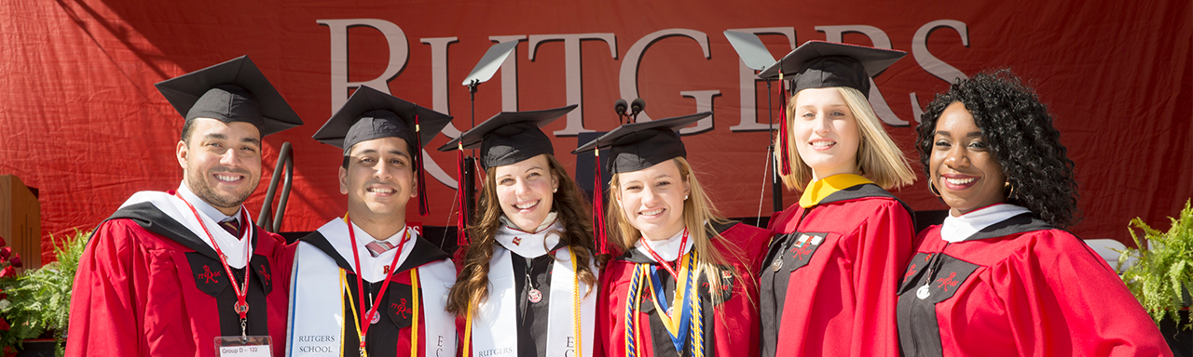
Points of Pride
A historic university–chartered in 1766
Devoted to serving New Jersey
Renowned faculty–numerous awards and accolades
Preparing tomorrow’s leaders through exceptional education
Leader in academic health care
Recognized as one of the world’s top universities
31

Slide 32
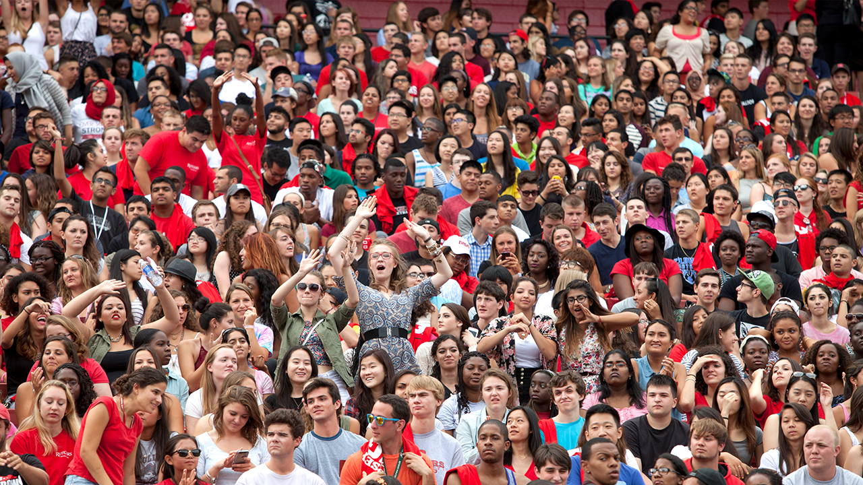
By the Numbers
81%
in-state
residents
29
schools and colleges
150+
undergrad
majors
71,000
students
18,000+
degrees awarded annually
530,000+
alumni
20,000+
faculty and staff
400+
grad programs
32
Presentation revised August 2021. Data on this slide current as of December 2019.

Slide 33
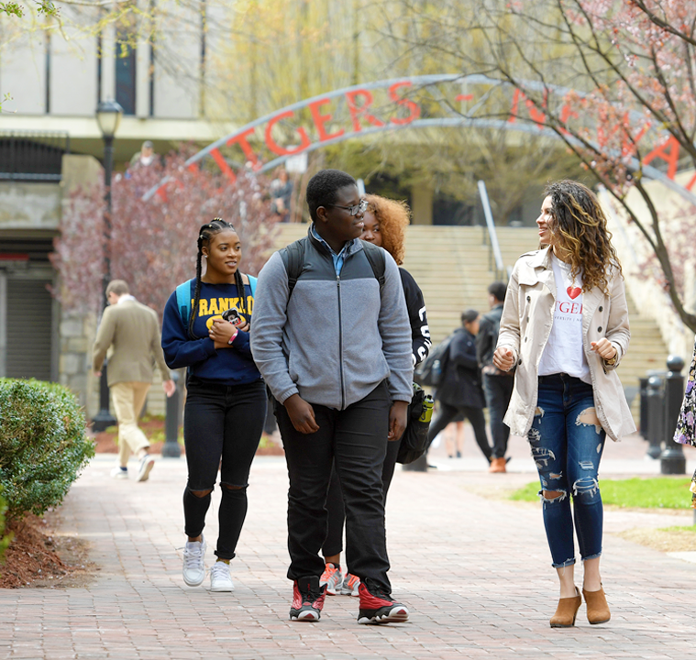
Fast Facts
Eighth-oldest university in America
Locations based in New Brunswick, Newark, and Camden, New Jersey
Public state university, providing affordable higher education
Focused on education, innovation, and community
Internationally recognized with world-class awards and honors
Diverse student population, from
50 states and 130 countries
33
Presentation revised August 2021

Slide 34

Presentation revised August 2021
Department of University Communications and Marketing
© 2021, Rutgers, The State University of New Jersey

Slide 35
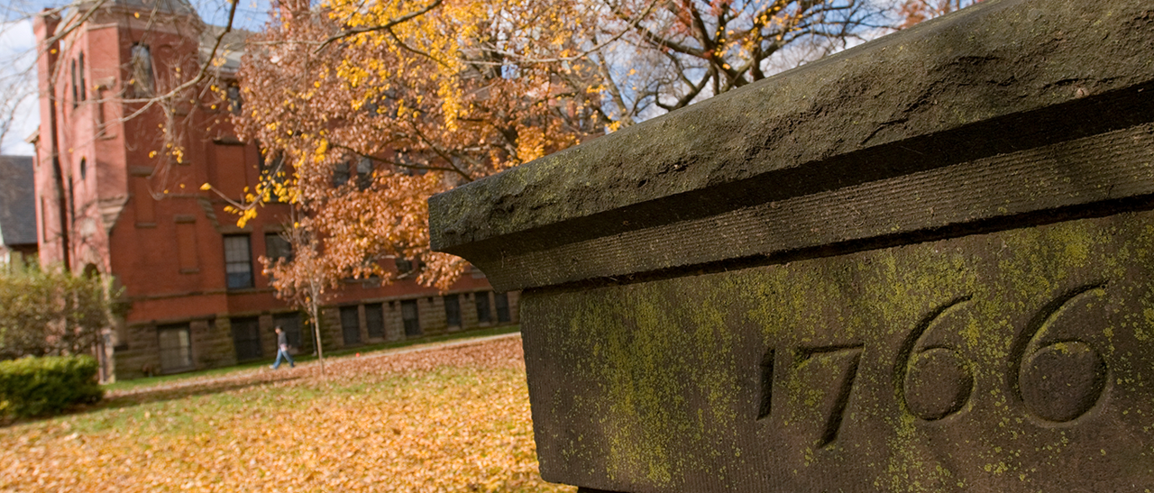

This is
Notes:
This is one of four alternative title pages for the PowerPoint. The photograph is from Rutgers University–New Brunswick.

Slide 36
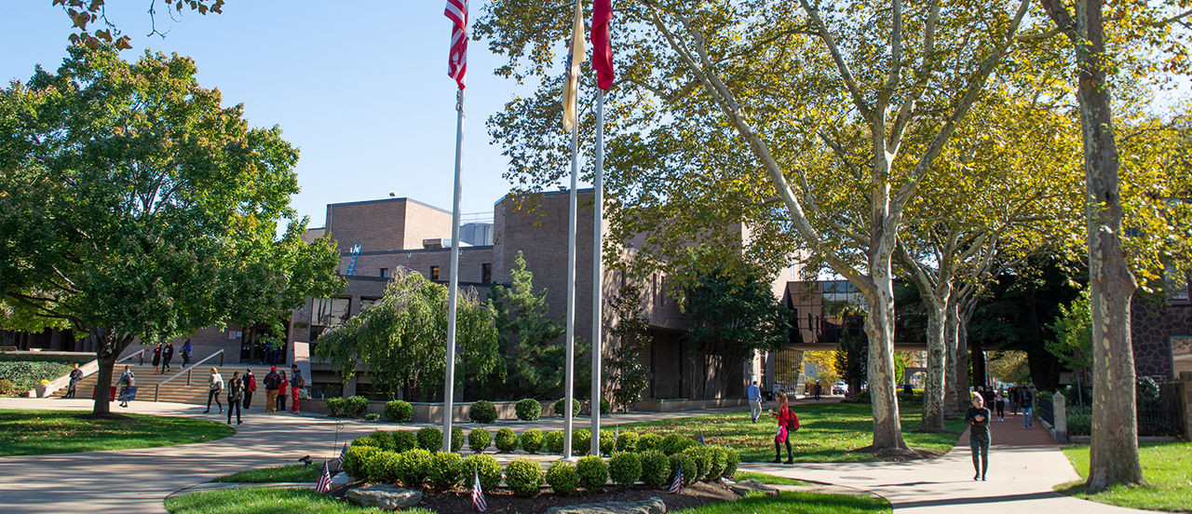
This is
Notes:
This is one of four alternative title pages for the PowerPoint. The photograph is from Rutgers University–Camden.

Slide 37
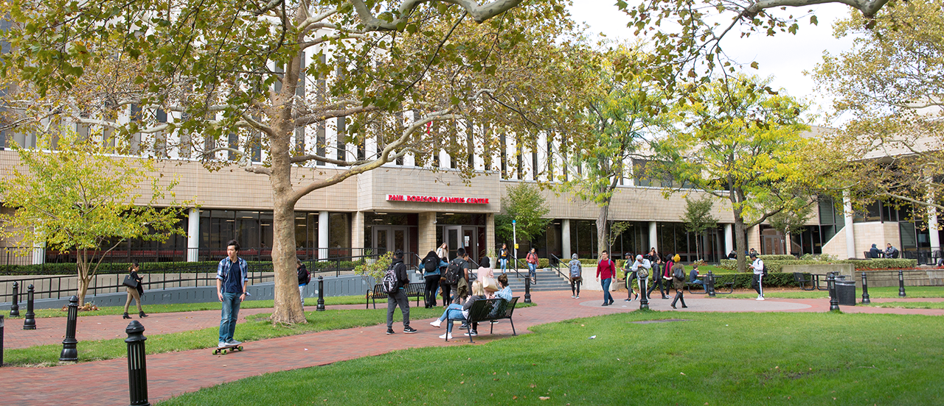
This is
Notes:
This is one of four alternative title pages for the PowerPoint. The photograph is from Rutgers University–Newark.

Slide 38
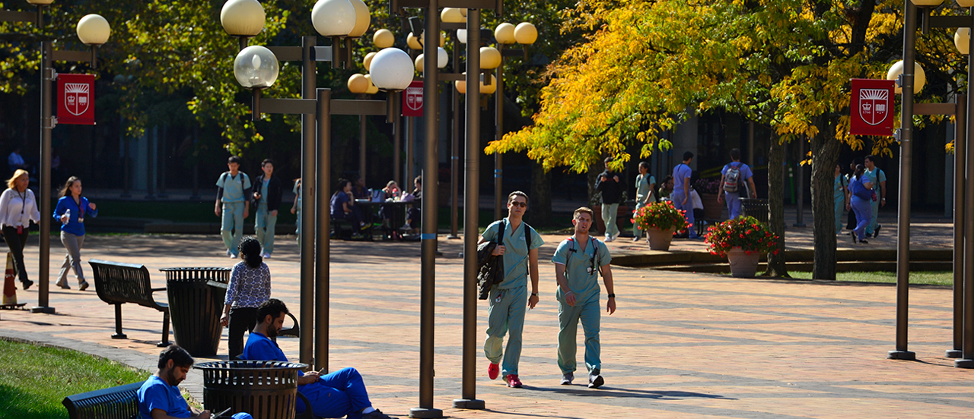
This is
Notes:
This is one of four alternative title pages for the PowerPoint. The photograph is from Rutgers Biomedical and Health Sciences.

