Slide 1

This Is Rutgers
COMMITTED TO ACCESS AND ACADEMIC EXCELLENCE,
BUILDING A BELOVED COMMUNITY, AND SERVING THE COMMON GOOD

Slide 2
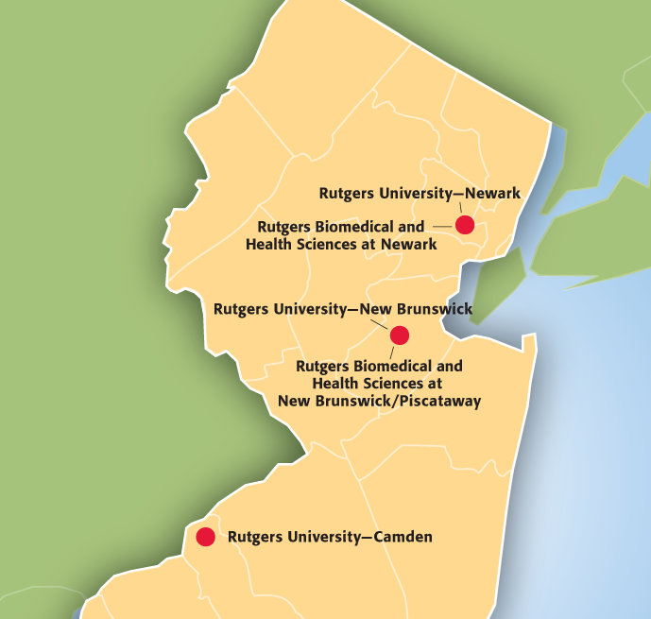
The State University of New Jersey
Providing access to life-changing education
Educating students in northern, central, and southern New Jersey
Internationally recognized, comprehensive public research university
Renowned faculty and award-winning students
Contributing to our communities, the nation, and the world through academics, research, clinical care, and collaboration
Engaged locally, nationally, and globally in service for the common good
1
Revised September 2023

Slide 3
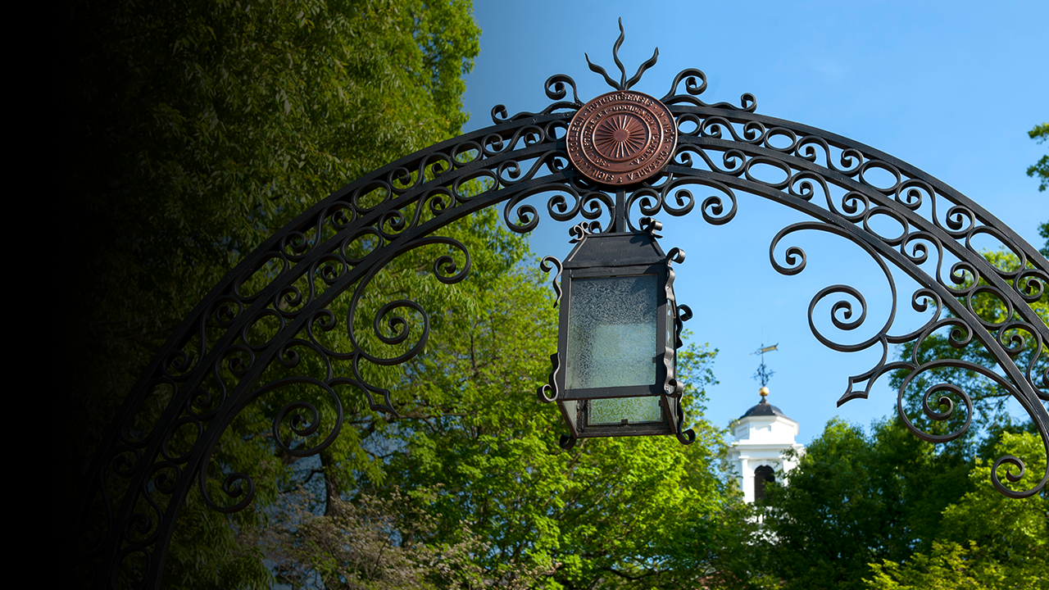
Rutgers’ Mission
Rutgers’ threefold mission focuses on
Providing for the educational needs of New Jersey through our undergraduate, graduate, and continuing education programs
Conducting cutting-edge research that contributes to the health, environmental, social, and cultural well-being of the state, nation, and world, as well as strengthening the economy and supporting businesses and industries
Performing public service in response to the needs of the people of the state and their local, county, and state governments
2
Revised September 2023

Slide 4
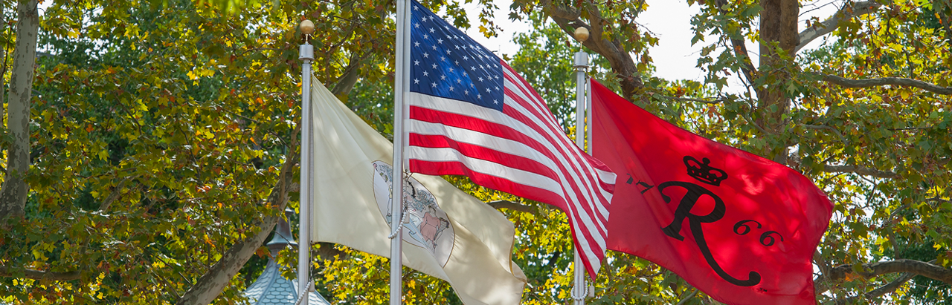
Our Values
Academic Excellence: Committed to inclusive access for all students with an aspiration to be the national model for outstanding academic programs, social mobility, and educational equity
Beloved Community: Building a culture of mutual respect and collaboration, enabling active citizenship, instilling a commitment to community through service, and providing meaningful engagement postgraduation
Common Good: Creating, sharing, and applying knowledge to improving the lives of the people of New Jersey, the nation, and the world by collaborating with local and global partners to address societal challenges
3

Slide 5

Our Structure
OFFICE OF THE PRESIDENT
University Divisions
Rutgers University–Camden
Rutgers University–Newark
Rutgers University–New Brunswick
Rutgers Health
Central Administration
Academic Affairs
Ethics and Compliance
External Affairs
Finance and Administration
General Counsel
Information Technology
Institutional Planning and Operations
Research
Rutgers University Foundation
University Human Resources
University Secretary
4

Slide 6
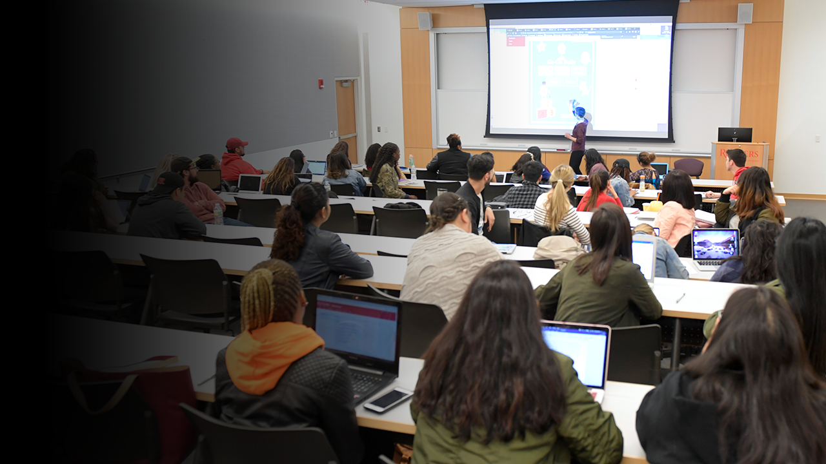
Education
Teaching over 67,600 students from across New Jersey, the United States, and the world
29 schools and colleges
150+ undergraduate majors and 400+ graduate programs
7,000+ continuing education programs
25,000+ classes taught annually
Ages 4 to 100+ taking courses as lifelong learners
19,000+ degrees granted to Rutgers students each year
5
Revised September 2023

Slide 7
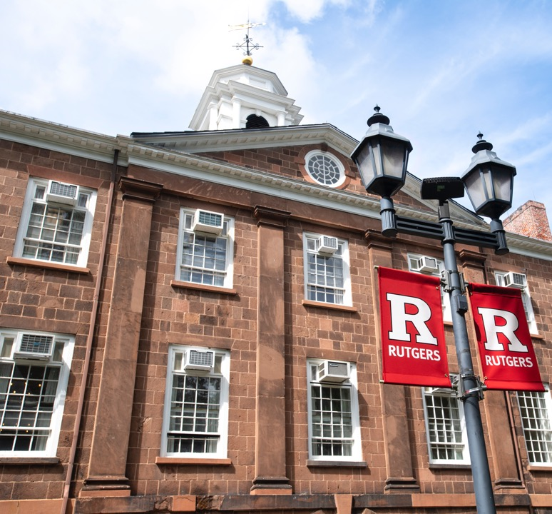
Rankings
U.S. News & World Report
Rutgers continues to be a top-ranked national public university.
Top 50 Public Universities
Rutgers–New Brunswick #15
Rutgers–Newark #40
Rutgers–Camden #49
For the first time in the 40-year history of the rankings, all three Rutgers locations rank as top national universities.
Top 100 National Universities
Rutgers–New Brunswick #40
Rutgers–Newark #82
Rutgers–Camden #98
U.
6
Revised September 2023
Notes:
Stat from Beth Salamon—continuing ed

Slide 8
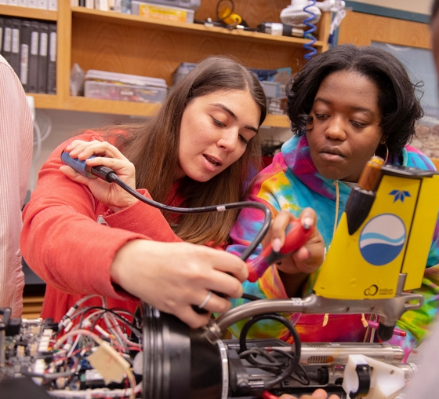
Innovation
Research with impact on people and communities around the world
New Jersey’s most extensive and diversified network of research laboratories
$673 million in R&D expenditures
(FY 2021)
$929.1 million in sponsored programs and research grants (FY 2023)
1,267 active patents (FY 2023)
Annual research and development expenditures exceed those of all other New Jersey colleges and universities
7
Revised September 2023

Slide 9

Community
Collaborating with our host communities
Outreach in all 21 New Jersey counties
Working to protect vulnerable environmental and urban areas with innovative sustainability measures
Hundreds of student volunteer hours: clinical care, legal assistance, tax preparation, neighborhood engagement
Crisis hotlines: caregivers, K–12 school employees, mothers, poison control, police officers, suicide prevention, veterans
Innovative partnerships with K–12 districts and county colleges statewide
8

Slide 10

Health Care
Rutgers Health combines biomedical education, research, and health care to empower students, providers, and patients
2.8 million+ annual patient visits
Thousands of health care providers
350+ ongoing clinical trials
Comprehensive health care including medical, dental, nursing, and behavioral health patient services
Rutgers Cancer Institute: New Jersey’s only National Cancer Institute-designated Comprehensive Cancer Center
In partnership with RWJBarnabas Health, one of New Jersey's largest academic health system
World-class translational research that transforms patient care
9
Notes:
Stats from Great Things 2022, Jackie Kozlosky.

Slide 11

Diversity
Rutgers strives to create an environment of inclusiveness in which everyone, regardless of culture, race, and socioeconomic background, can exchange ideas freely and safely
Rutgers enhances its accessibility and affordability through innovative initiatives: Rutgers Future Scholars, RU-N to the Top, Bridging the Gap, and Scarlet Guarantee, among others
Campus Pride ranks Rutgers–New Brunswick among its Best of the Best Honorees for its commitment to serving LGBTQ+ students
U.S. News & World Report Campus Diversity Rankings rank Rutgers–Newark #6
10
Notes:
Campus Pride is language agreed to with OIRAP. We aren’t on the current list of the best. Newark is the latest ranking from US News.

Slide 12
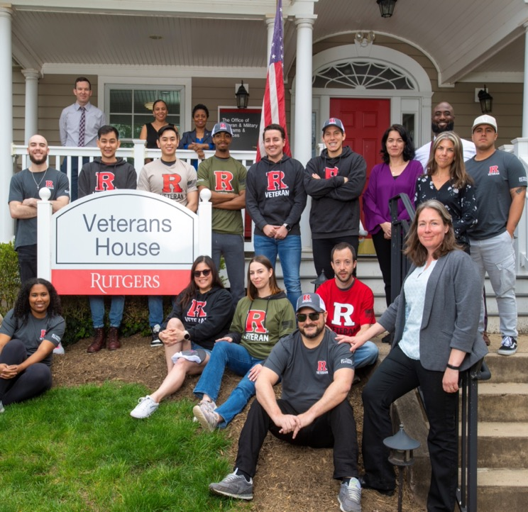
Best for Vets
Rutgers ranks 13th in the nation, Military Times Best for Vets
Rutgers is ranked highly by U.S. News & World Report for vets, with Rutgers–New Brunswick #22
Rutgers–Camden named a Purple Heart University for its veteran services—the first New Jersey university to earn the distinction
Rutgers offers more than 100 continuing education programs that are approved and eligible for veteran funding
11

Slide 13
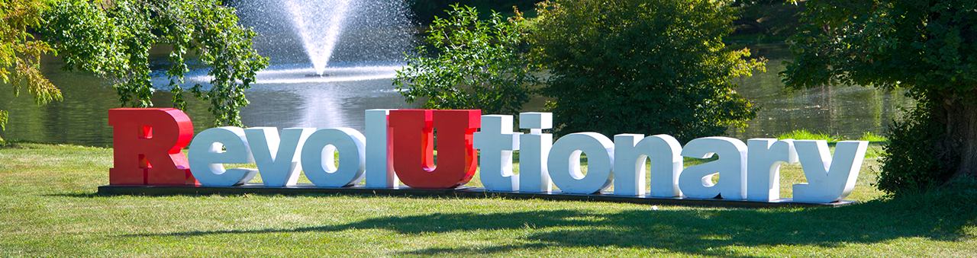
Over 250 Years
Eighth-oldest institution of higher learning in the
United States
Founded in 1766 as Queen's College, a private
all-male college; would later become Rutgers College, and now Rutgers–New Brunswick
Rutgers–New Brunswick became New Jersey's land-grant institution in 1864
Legislation in 1945 and 1956 designated Rutgers as
The State University of New Jersey
University of Newark (now Rutgers–Newark) joined Rutgers in 1946
College of South Jersey (now Rutgers–Camden) joined Rutgers in 1950, which gave Rutgers a statewide presence
  Rutgers Biomedical and Health Sciences, known as Rutgers Health, established in 2013 with the integration of most units of the former University of Medicine and Dentistry of New Jersey
12

Slide 14
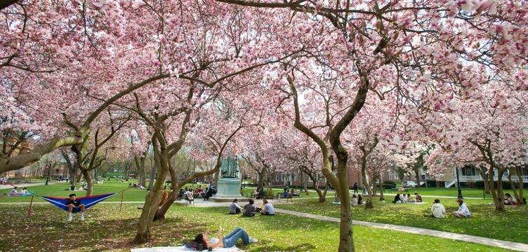
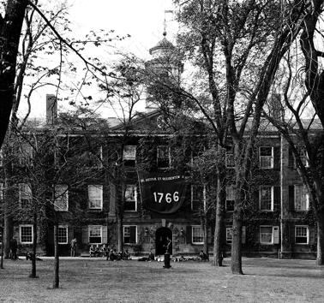
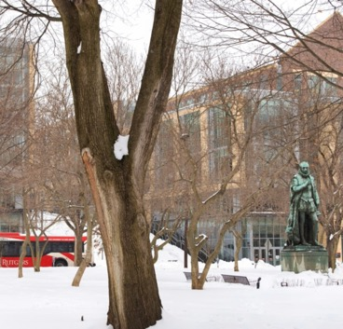
  Our Roots
  New Brunswick
Birthplace of Rutgers: Founded in 1766 as Queen’s College and renamed Rutgers College in 1825
Named New Jersey’s land-grant institution
in 1864, resulting in Cook College, today’s School of Environmental and Biological Sciences
New Jersey College for Women (now Douglass Residential College) opens in 1918
Rutgers designated as The State University of New Jersey in 1945
Graduate School–New Brunswick opens
in 1952 (now School of Graduate Studies)
The experimental Livingston College founded in 1969
Rutgers College goes coed in 1972
Joins Association of American Universities, the leading 71 research universities in North America, in 1989
Joins the Big Ten in 2014
13

Slide 15
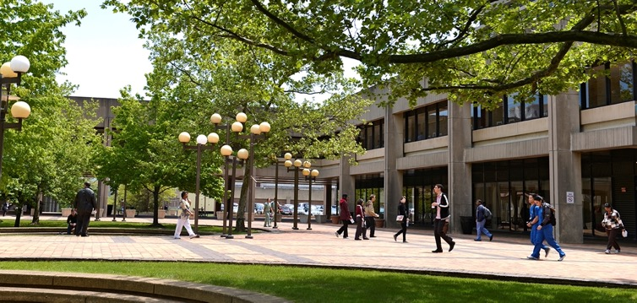
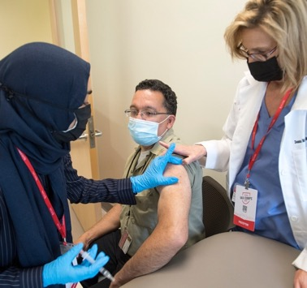
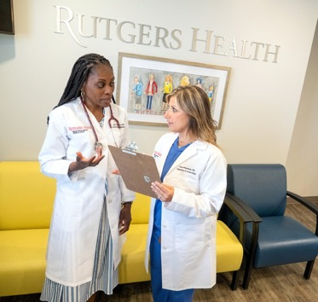
  Our Roots
  Rutgers Health
Established in 2013 as Rutgers Biomedical and Health Sciences. The Rutgers Health brand name, adopted in 2023, includes clinical care, education, and research
Expands Rutgers’ mission to combine research innovation with academic patient care
New Jersey’s leading academic health care system, offering exceptional patient care in coordination with partner RWJBarnabas Health
Offers access to routine and complex treatments, compassionate and lifesaving care, and providers who are translating research and discoveries into new cures, advanced therapies, and specialized treatments
14

Slide 16
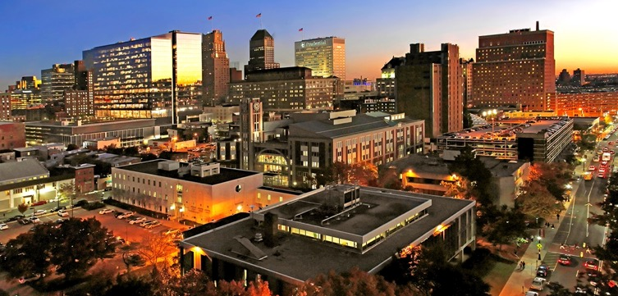
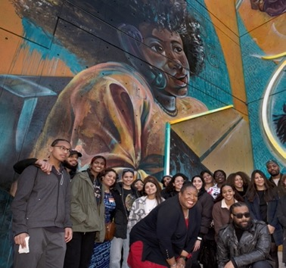
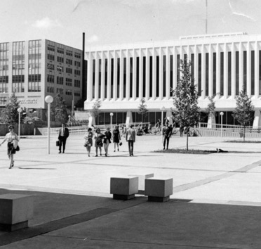
  Our Roots
  Newark
Rutgers–Newark is a diverse, urban research university, where opportunity meets excellence—an anchor institution in New Jersey’s largest city
New Jersey Law School opens in 1908
University College opens in Newark in 1934
Dana College, New Jersey Law School, and Seth Boyden School of Business merge to create University of Newark in 1936
The University of Newark joins Rutgers in 1946 (now Rutgers–Newark)
Transformation inspired by takeover of Conklin Hall by Black Organization of Students in 1969
Graduate School–Newark founded in 1975
Law schools in Newark and Camden merge to become one Rutgers Law School in 2015
15

Slide 17
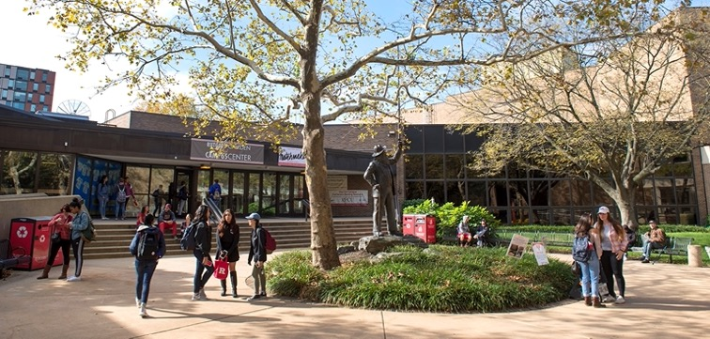
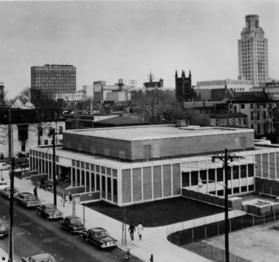
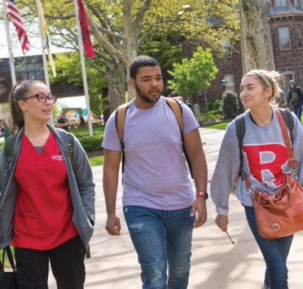
  Our Roots
  Camden
Rutgers–Camden, a leading urban public research university emphasizing civic engagement, is a key institution for southern New Jersey and the Delaware Valley
South Jersey Law School founded in 1926; College of South Jersey opens in 1927
College of South Jersey and South Jersey Law School join Rutgers in 1950 (now Rutgers–Camden)
School of Business–Camden started in 1988
School of Nursing–Camden started in 2011
Law schools in Newark and Camden merge to become one Rutgers Law School in 2015
16

Slide 18

Our Students
67,600+
students from
50 states and
120+ countries
34%
of first-year students are first-generation undergrads
82%
are New Jersey
residents
Students
come from every New Jersey
county
17
Presentation revised November 2022

Slide 19
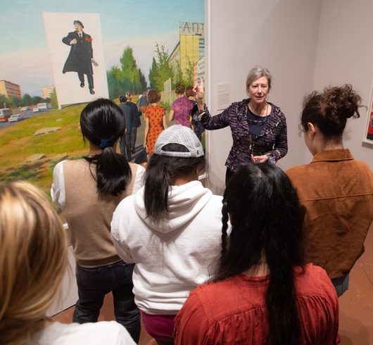
Our Faculty
Rutgers employs more than 8,000 full- and part-time faculty
Recipients of honors, awards, grants, and fellowships such as the Pulitzer Prize, MacArthur “Genius” Grants, and Guggenheim and Sloan Fellowships
71 members of the National Academies (Sciences, Engineering, and Medicine) and American Academy of Arts and Sciences
125+ American Association for the Advancement of Science fellows
1,500 international scholars representing 100 countries bring their expertise to Rutgers
18

Slide 20
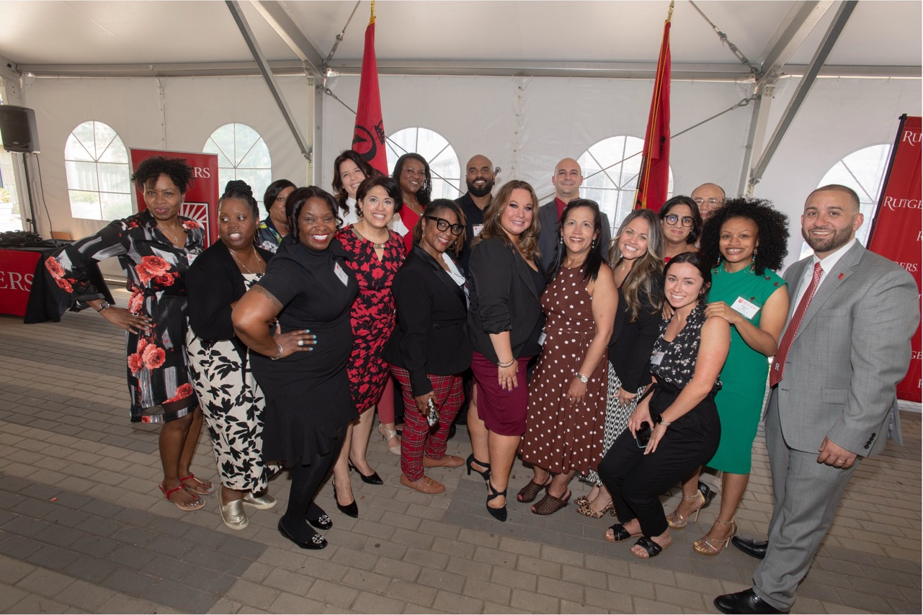
Our Staff
The university employs more than 14,100 full- and part-time staff
Support the university's academic, research, community engagement,
and student life programs
1,000-plus information technology staff handle 4 quadrillion bytes of monthly internet traffic and are responsible for 30,000-plus centrally managed computers
Rutgers University Police Department is one of only 17 law enforcement agencies in the state to be accredited by Commission on Accreditation for Law Enforcement Agencies
Revised September 2023
19

Slide 21

Our Alumni
Worldwide community of more than 585,000 alumni
More than half reside in New Jersey
Work in virtually every field, from
the public sector and nonprofits to Fortune 500 companies
Have earned prominent recognition such as the Nobel Prize, National Medal of Technology and Innovation, Pulitzer Prize, Grammy Award, and Emmy Award
20
Revised September 2023

Slide 22
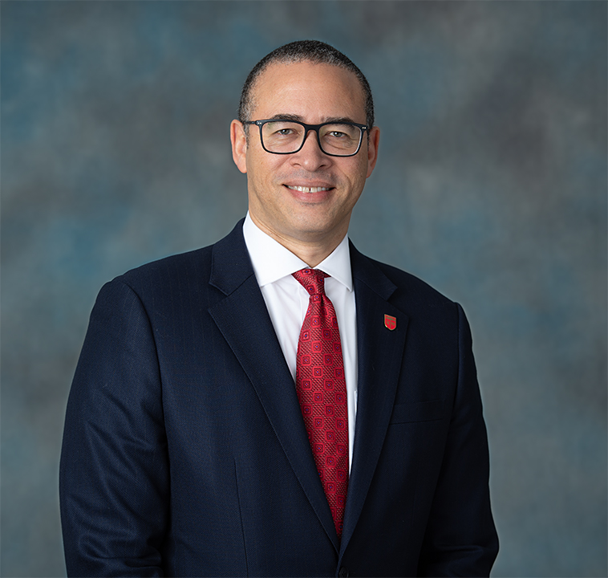
  Leadership
  President Jonathan Holloway
Appointed 21st President of Rutgers in 2020
Eminent scholar of history and African American studies, specializing in post-emancipation social and intellectual United States history
Member of the American Academy of Arts and Sciences and the Society of American Historians
Major initiatives include the university's Scarlet Promise Initiative, Climate Action Plan, Diversity Strategic Plan, and Scarlet Service Initiative
21

Slide 23
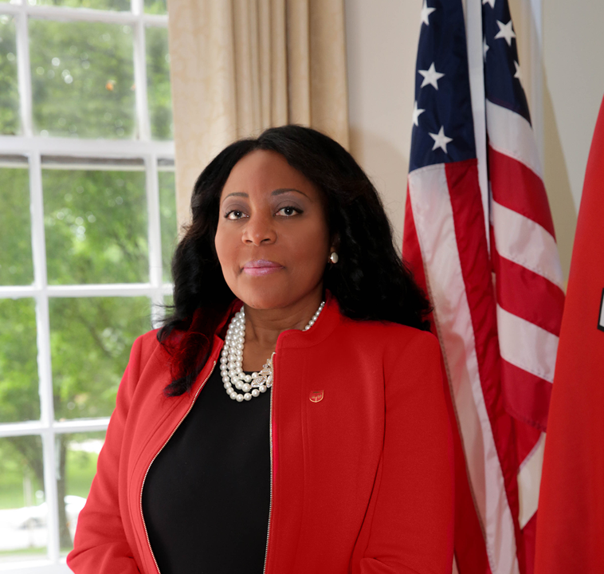
  Leadership
  Chancellor Francine Conway
Named Chancellor, Rutgers–New Brunswick in 2023
Served as Chancellor-Provost since 2021 and previously as Provost
Leads Rutgers flagship institution with more than 43,000 students and 12 degree-granting schools
Champions a comprehensive Academic Master Plan with four pillars of excellence: scholarly leadership, innovative research, student success, and community engagement
Internationally recognized child psychologist, Distinguished Professor, and former dean of Rutgers’ Graduate School of Applied and Professional Psychology
22

Slide 24
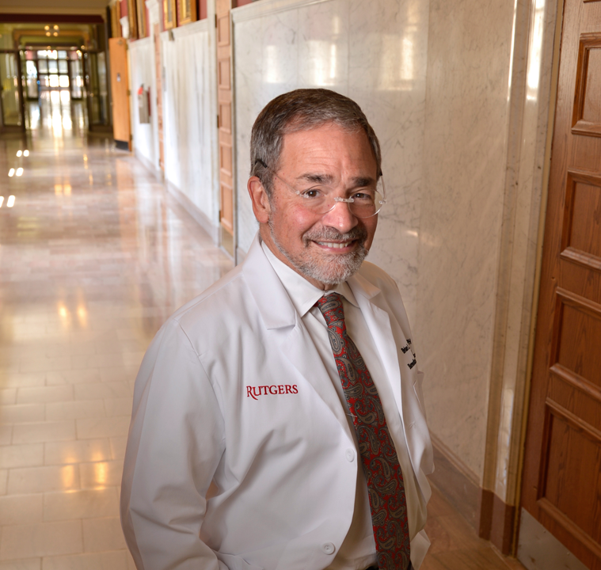
  Leadership
  Chancellor Brian Strom
Inaugural Chancellor of Rutgers Biomedical and Health Sciences
Executive Vice President for Health Affairs at Rutgers University
Leads Rutgers Health, strengthening medical and other health professions education, research, and practice in New Jersey
Expertise spans many areas of clinical epidemiology
Major research interest is in the field of pharmacoepidemiology
Nationally recognized leader in clinical research training
23

Slide 25

  Leadership
  Chancellor Nancy Cantor
Named Chancellor, Rutgers–Newark in 2014; Distinguished Professor of Psychology
Leads strategic plan focused on access and affordability, publicly engaged scholarship, and the university’s role as an anchor institution
Recognized nationally and globally as an advocate for reemphasizing higher education’s public mission
Lectures and writes on universities rewarding public scholarship, sustainability, the status of women in the academy, and racial justice and diversity
Prominent social psychologist, fellow of the American Academy of Arts and Sciences, and member of the National Academies
24
Presentation revised November 2022

Slide 26
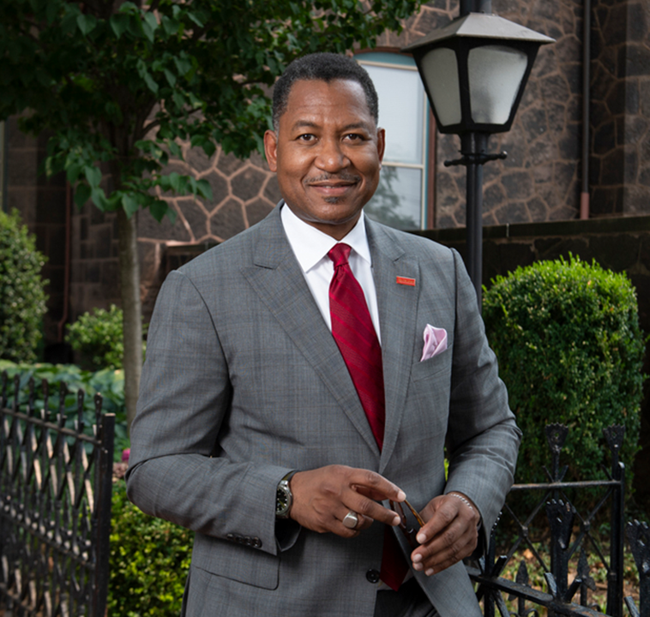
  Leadership
  Chancellor Antonio Tillis
Named Chancellor, Rutgers–Camden in 2021
Leads institutional commitment to serving as an anchor institution in Camden and throughout South Jersey and the Delaware Valley
Responsible for 6,000 students in a wide variety of undergraduate and graduate programs
Prominent scholar of Latin American literature and in the field of Afro-Hispanic studies
Focus on strategic planning; civic engagement; research collaborations; and the Truth, Racial Healing and Transformation Center
25

Slide 27
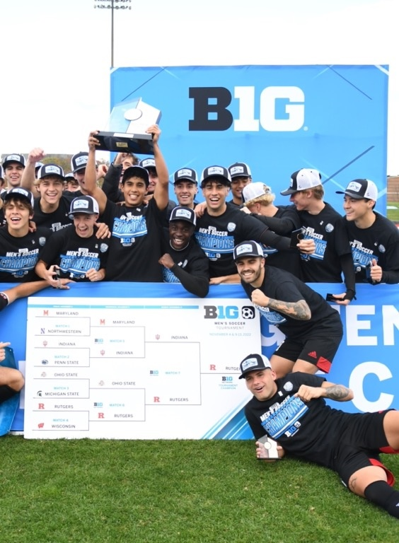
Athletics
Rutgers Scarlet Knights
New Brunswick, Division I
24 sports
Big Ten Conference
Birthplace of college football, 1869
Rutgers Scarlet Raiders
Newark, Division III
14 sports
New Jersey Athletic Conference
Rutgers Scarlet Raptors
Camden, Division III
17 sports
New Jersey Athletic Conference
More Ways to Play and
Compete
Sports Clubs
Intramurals
Recreation
26
Revised September 2023

Slide 28

Rutgers University Libraries
Universitywide Resources
For Faculty, Students, and Staff
Research Guides and Assistance
Teaching Support
Student Success Initiatives
Top Databases
Online Clinical Tools
Digitized Collections
Top Facilities
Locations Universitywide
Special Collections and University Archives
Specialty Libraries
  Law
  Science and Medicine
  Art
  Math and Physics
Institute of Jazz Studies
Collaborative Spaces
27
Revised September 2023

Slide 29

Outreach & Extension
Became New Jersey’s land-grant institution in 1864
New Jersey Agricultural Experiment Station provides a diverse range of research and educational programs through its cooperative extension specialists, helping to fulfill Rutgers–New Brunswick’s land-grant role
Serves residents in urban, suburban, and rural communities in all 21 New Jersey counties
Continuing education programs serve more than 113,200 lifelong learners
annually between ages 4 and 100+
28
Revised September 2023
Notes:
Stat from Beth Salamon—continuing ed

Slide 30
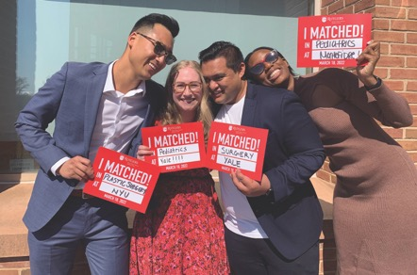
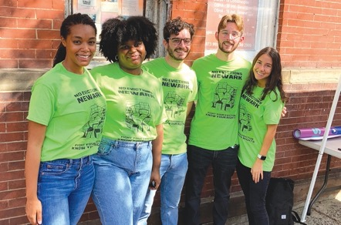
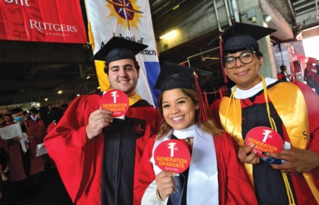
Points of Pride
A historic university–chartered in 1766
Among leading research universities, acclaimed for the excellence and achievements of our people and for contributions to society in the pursuit of education, research, and health care
Serves New Jersey, the nation, and the world
Public research university offering extensive opportunities with smaller communities for individualized enrichment
Focused on real-world applications of academics and translational research
Preparing tomorrow’s leaders through exceptional education and experiential learning
29

Slide 31
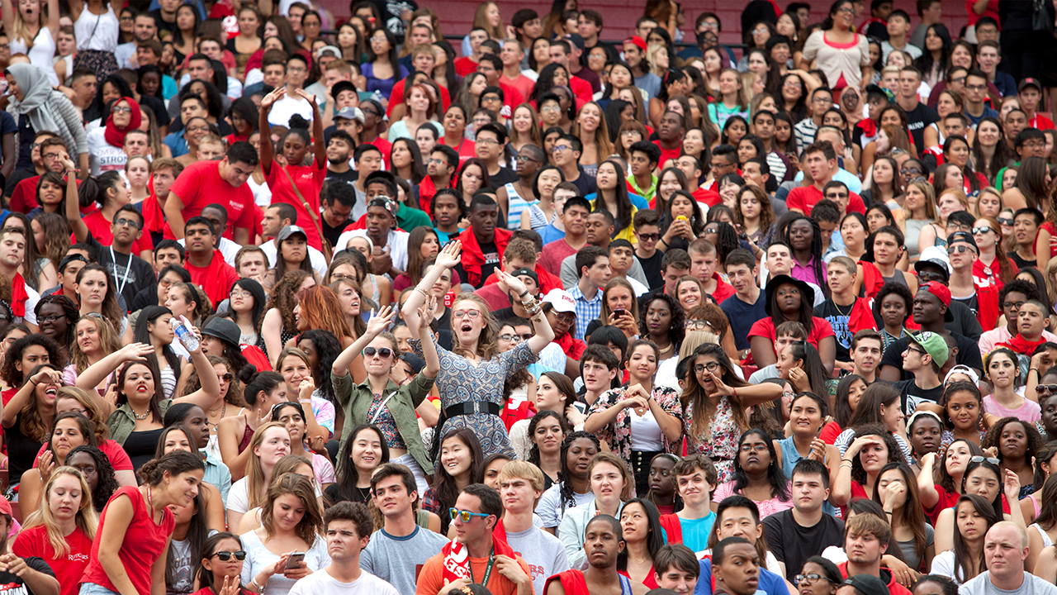
By the Numbers
82%
in-state
residents
29
schools and colleges
150+
undergrad
majors
67,600+
students
19,000+
degrees awarded annually
585,000+
alumni
22,100+
faculty and staff
400+
grad programs
30
Revised September 2023

Slide 32
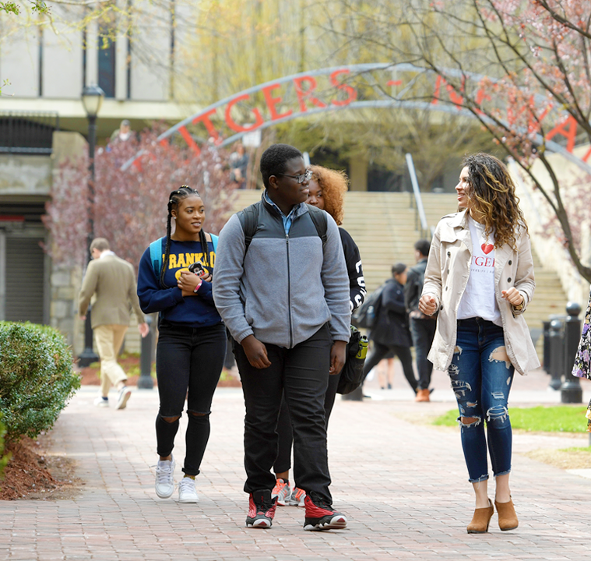
Fast Facts
Eighth-oldest university in America
Locations based in New Brunswick, Newark, and Camden, New Jersey
Public state university, providing an excellent value in higher education
Focused on education, clinical care, innovation, and community
Internationally recognized with world-class awards and honors
Diverse student population, from
50 states and 120+ countries
31
Revised September 2023

Slide 33

Presentation revised September 2023
Department of University Communications and Marketing
© 2023, Rutgers, The State University of New Jersey

Slide 34
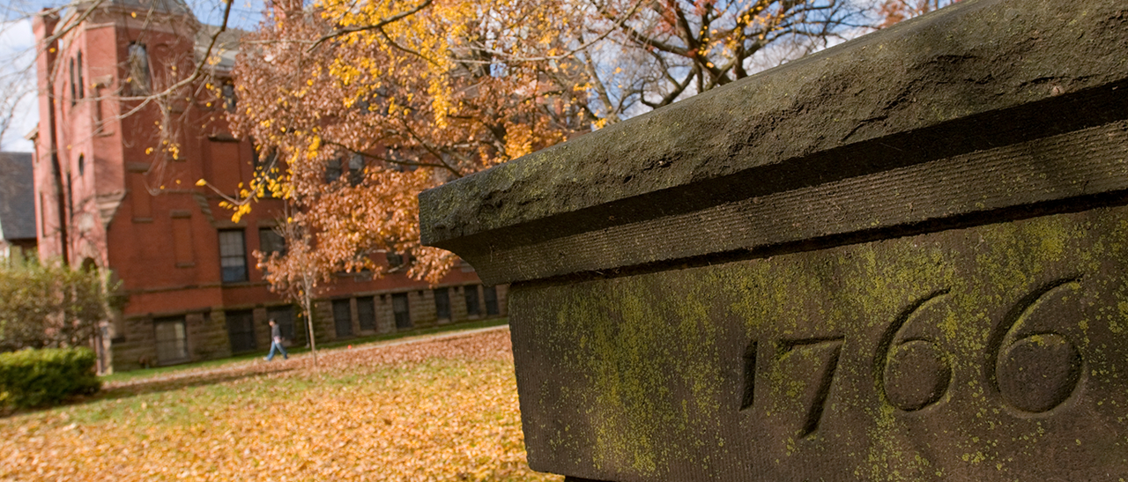

This Is Rutgers
COMMITTED TO ACCESS AND ACADEMIC EXCELLENCE, BUILDING A BELOVED COMMUNITY, AND SERVING THE COMMON GOOD
Notes:
This is one of four alternative title pages for the PowerPoint. The photograph is from Rutgers–New Brunswick.

Slide 35
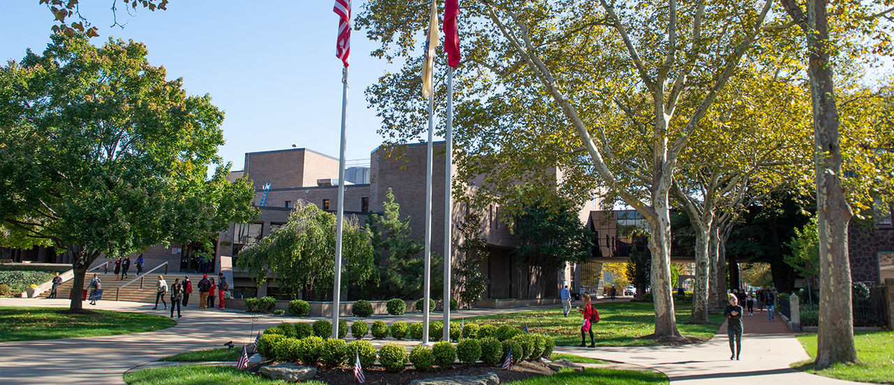

This Is Rutgers
COMMITTED TO ACCESS AND ACADEMIC EXCELLENCE, BUILDING A BELOVED COMMUNITY, AND SERVING THE COMMON GOOD
Notes:
This is one of four alternative title pages for the PowerPoint. The photograph is from Rutgers–Camden.

Slide 36
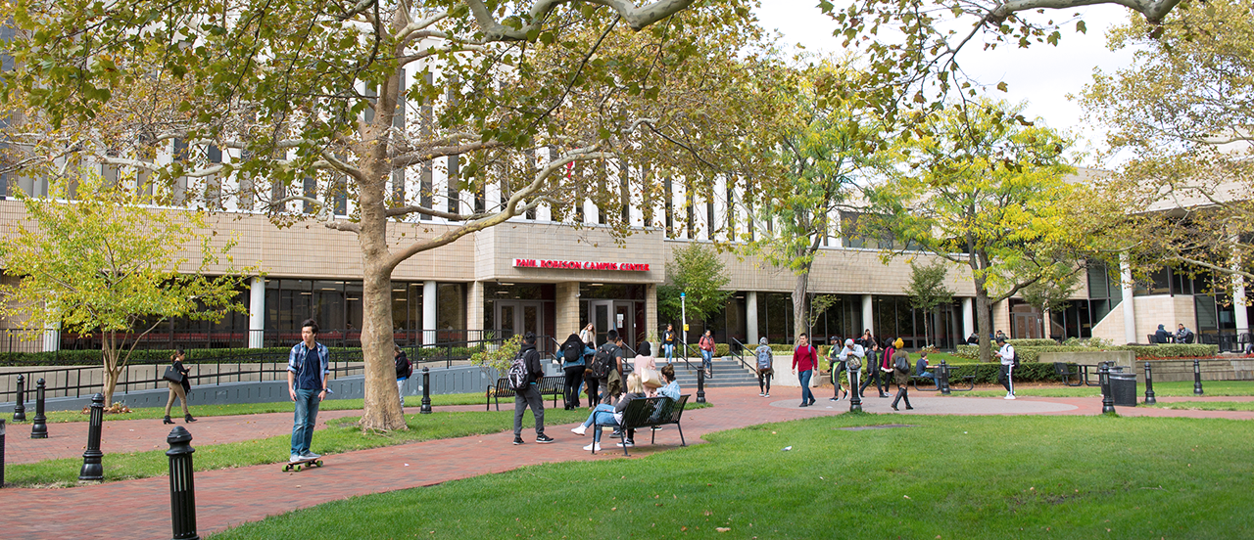

This Is Rutgers
COMMITTED TO ACCESS AND ACADEMIC EXCELLENCE, BUILDING A BELOVED COMMUNITY, AND SERVING THE COMMON GOOD
Notes:
This is one of four alternative title pages for the PowerPoint. The photograph is from Rutgers–Newark.

Slide 37
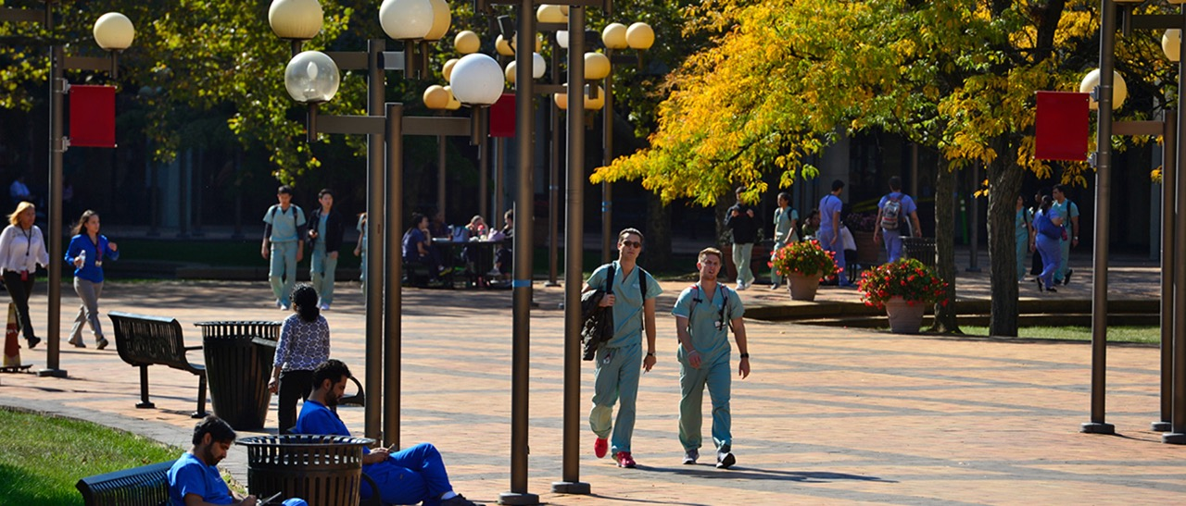

This Is Rutgers Health
COMMITTED TO ACCESS AND ACADEMIC EXCELLENCE, BUILDING A BELOVED COMMUNITY, AND SERVING THE COMMON GOOD
Notes:
This is one of four alternative title pages for the PowerPoint. The photograph is from Rutgers Health.

